Slide 1

Individual Meeting
Year 2024 -2025

Slide 2
Individual Meeting
Year 2024 -2025

Slide 3
Update Research: 25-09-2024

Slide 4
Content
Discussion of Simulation-Based Inference for Parameter Estimation of Complex Watershed Simulators (p.15)
Monday Meeting
Ameri-flux
Subset-tools
Next Week Plan
Time Management/ Schedule

Slide 5
Simulation-Based Inference for Parameter Estimation of Complex Watershed Simulators
Limitations :
Types of computational Demands and Complex Responses that made the calibration of PB simulators infeasible .
Relation between the Conditional Probability and the complex responses of simulators.

Slide 6
Mechanism of Simulation-Based Inference: Parameter Estimation and Model Calibration
The SBI works by learning the relationship between the model's parameters (inputs) and the observed data. It identifies how changes in these parameters affect the model's output by running many simulations and comparing the results with real-world data. Once this relationship is understood, SBI can estimate the best parameters that explain the observed data.

Slide 7
Process Based Simulators (PB)
The process-based simulators are physical-based model, used to represent hydrologic states and fluxes at multiple scale.

Slide 8
Questions
Employ a density-based neural network to represent the joint probability of parameters and data without strong assumption about its functional form (p.1)
Performing weighting approach to the SBI framework (p.1)
How the PB simulators are widely employed in the study of complex catchment processes and their responses to a changing climate while their calibrations remain a significant challenges (p.1)

Slide 9
Update Research: 02-10-2024

Slide 10
Discussion Monday Meeting: Amanda’s Meeting
Numerical Computations in Par flow
Implement an Emulator (SBI) to faster the computational phase.
Sequential Method in SBI that consists of narrowing the range of observations (computationally expensive).
Emulator is trained on Par flow Behavior , and hence the performance of the Par flow can be the same as the Par Flow model or less.
Creating a vector for each sample member (each point has its own vector which illustrate the streamflow for 30-days for example).

Slide 11
Discussion Monday Meeting: Amanda’s Meeting
SBI looks to the vector (can be streamflow or Manning’s Values) that are given and try to understand the relation between the different parameters to be able to start by prediction of values.
It starts to understand the distribution within the vector based on the simulation and starts by predicting the result.
SBI means that we are inferring what are the parameters are based on close are the simulated values are to the observed values.
Shrinking the range is just to speed up the model and save computationally steps.

Slide 12
Discussion Monday Meeting
Discussion of the posterior density estimation and the total number of runs of simulations and accuracy of results.
Discussion of the Manning’s vector and its different groups.
After getting these values, streamflow hydrograph and comparing it to the observations (as much as it gets tighter to the observational data , as much as the result from the simulation is correct).

Slide 13
Monday Meeting
SBI _ Prototype Slack Channel
GIT HUB Subscription
Add me to the GIT HUB (Private Account) + message on Slack to add me on the GIT HUB
Schedule a Meeting before start working on GIT HUB
Get familiar with the code
Third step is to do a step example (try to run a simulation like the one that I saw them on the graphs)
Working on different branches on GIT HUB

Slide 14
Ameriflux / Subsetools
Ameri flux Energy Fluxes Point Data
Ameri flux can’t be an input for Par flow
Subset-Tools Grid Level

Slide 15
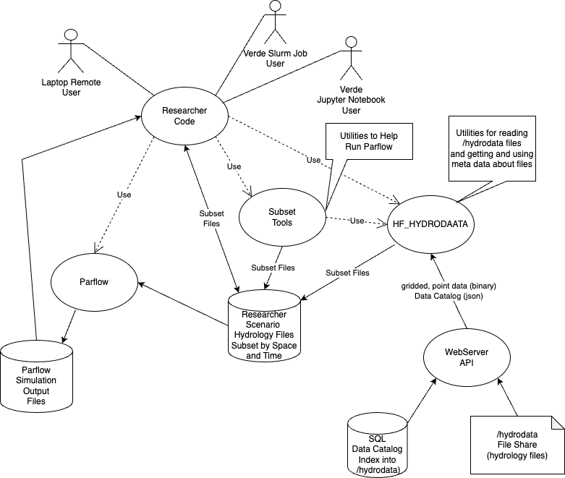
Summary

Slide 16
Update Research: 06-11-2024

Slide 17
Part 1: Collection of Data

Slide 18
Data Collection: Sources
Collecting data from ParFlow-CLM simulations alongside observational data from AmeriFlux provides a realistic range of possible values. By incorporating observational data to the simulated data range, we achieve a closer convergence to real-world values, enhancing the accuracy and reliability of the model

Slide 19
Time Series Resolution
An hourly time series can capture the fluctuations in latent heat throughout the day. It allows for a more precise analysis of the relationships between latent heat and environmental factors influencing its behavior.

Slide 20
Location: Influencing Factors
Air Temperature: Higher air temperatures increase the rate of evaporation and transpiration.
Humidity Levels: When the air is saturated with moisture, less evaporation occurs.
Wind Speed: Wind enhances evaporation by removing saturated air and replacing it with drier air, allowing more moisture to evaporate.

Slide 21
Soil Moisture: Wet soils allow more water to evaporate, leading to higher latent heat fluxes.
Solar radiation: Solar radiation is the primary energy source for evaporation and transpiration. High radiation levels increase surface temperature, leading to more evaporation.

Slide 22
Soil Moisture: Wet soils allow more water to evaporate, leading to higher latent heat fluxes.
Solar radiation: Solar radiation is the primary energy source for evaporation and transpiration. High radiation levels increase surface temperature, leading to more evaporation.

Slide 23
Location: Environmental Conditions
Environmental conditions for each location are checked using AmeriFlux data before running ParFlow-CLM. This ensures that we capture the full range of variability, allowing for an accurate representation of latent heat across different scenarios.

Slide 24
Location: Ameriflux Selection
This approach influences the selection of AmeriFlux site IDs used for comparison with simulated data from ParFlow. When two AmeriFlux sites are located close to each other under similar conditions, only the site with the most extensive data will be selected, as it provides greater data and captures variability across multiple years.

Slide 25
Time Period : Selection
The fact that each Ameriflux site covers different time periods is indeed a source of bias when trying to represent latent heat values in a single histogram. This leads to over representation of certain conditions or timeframe and under representation of others, skewing frequency distribution of Latent Heat values.
Proposed Solution: An approach to address bias due to differences in time periods is to assign a weight to each site based on its total number of observations.

Slide 26
Part 2 : Quality of Data

Slide 27
Data Quality Assessment
Collecting Data From Ameriflux - US-Ne2
Collecting Data From PFCLM RUN
Calculating the Difference Between Observed Data and ParFlow Model Output
Calculating the Percentage Error
Filtering the Data
Check the Proportion of Data Within Limits
Summary Statistics Calculation for Filtered Data

Slide 28
Collection of Data
Data was collected over a one-year period, starting on October 10, 2018, and ending on October 10, 2019, in the state of Nebraska. The AmeriFlux site for this data is US-Ne2.

Slide 29
Percentage of Error
This involves calculating the difference between the observed measurements from AmeriFlux and the values generated by the ParFlow run, and then calculating the percentage error for each data point, using the observation data as the reference.

Slide 30
Limits of Acceptability
To analyze data points with minimal deviation between ParFlow and AmeriFlux, we filter the DataFrame to include only rows where the percentage error is 15% or less.

Slide 31
Proportion of Filtered Data
The filtered data represents only 10% of the AmeriFlux and ParFlow-CLM datasets.

Slide 32
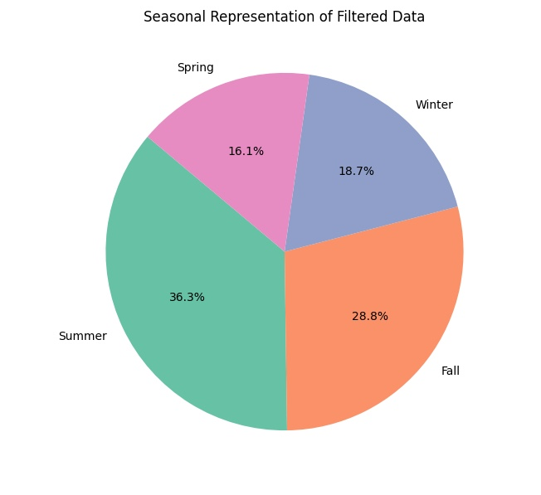

Slide 33
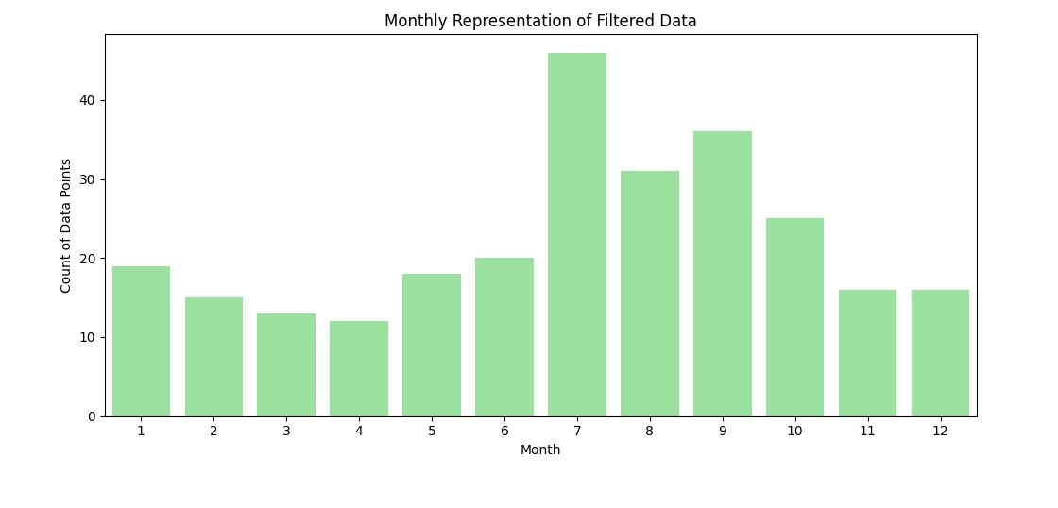
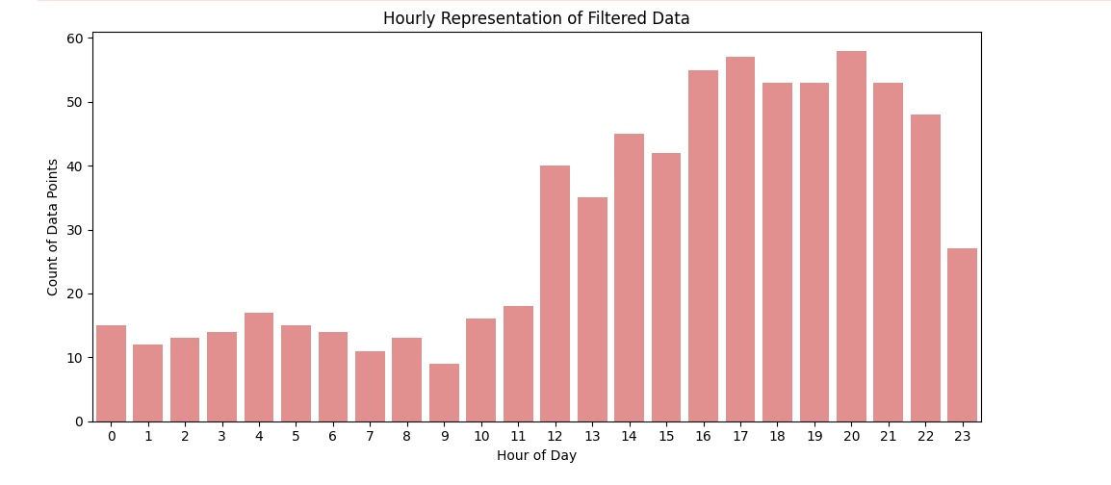

Slide 34
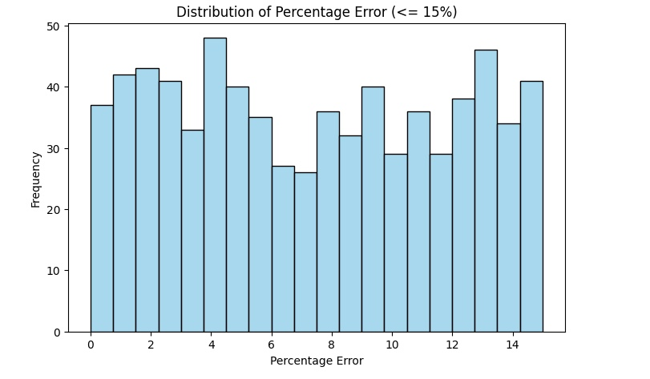
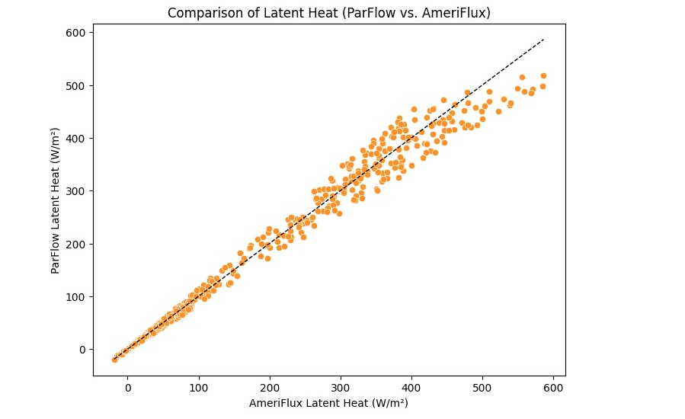

Slide 35
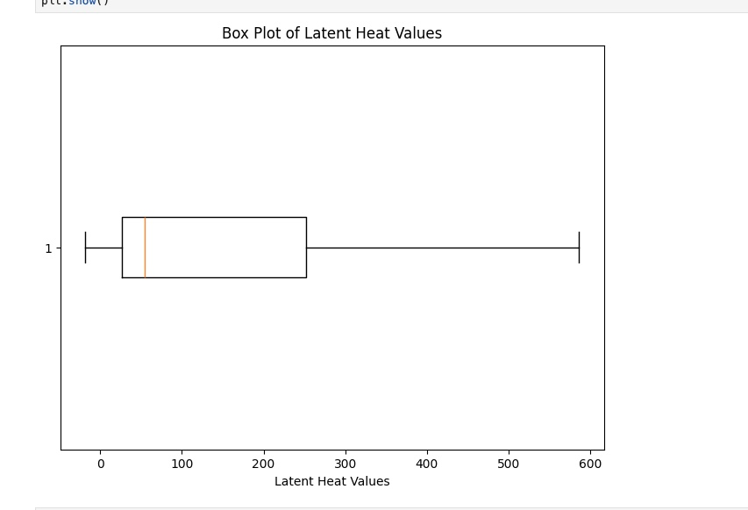

Slide 36
Analysis
Assessing the bias in the selection of points : if the points that are selected from a part of the domain where Parflow naturally perform better, this can introduce a positive performance bias. This would mean that the selected points do not fully represent the overall domain but instead reflects where Parflow is already known to perform better.
Therefore, this means that in areas with different environmental conditions where Parflow might struggle, the model is less likely to adapt accurately because the prior does not contain enough information.

Slide 37
Part 4: Prior Distribution
Planning to build a histogram that provides a visual frequency distribution of Latent heat
Converting the Histogram to a Probability distribution
Testing how well data fits distribution (normal, gamma, beta…)

Slide 38
Conversion Units
$$\frac{W}{m^{2}} ×\frac{kg}{2.5 × {10}^{6}J}×\frac{J}{W.s}×\frac{m^{3}}{W.s}×\frac{m^{3}}{1000 Kg}×\frac{1000 mm}{1 m }×\frac{86400s}{day}=0.035 mm/day$$

Slide 39
Update Research: 20-11-2024

Slide 40
Objective
The objective is to match the simulated data to the observed data by varying parameters and building the prior distribution. Today, the focus is on hydraulic conductivity and its alignment with the observed data.

Slide 41
Collection of Data
Data was collected over a one-year period, starting on October 10, 2018, and ending on October 10, 2019, in the state of Nebraska. The AmeriFlux site for this data is US-Ne2.

Slide 42
Single Column : USNe -2
A specific prior distribution has been assigned to the USNE-2 location. Each location has unique characteristics and, therefore, its own prior distribution.

Slide 43
US Ne2 : Hydraulic Conductivity
A sensitivity analysis has been conducted to assess the influence of the hydraulic conductivity on the simulated latent heat and how its variations leads to matching the observation data collected from Ameri flux.

Slide 44
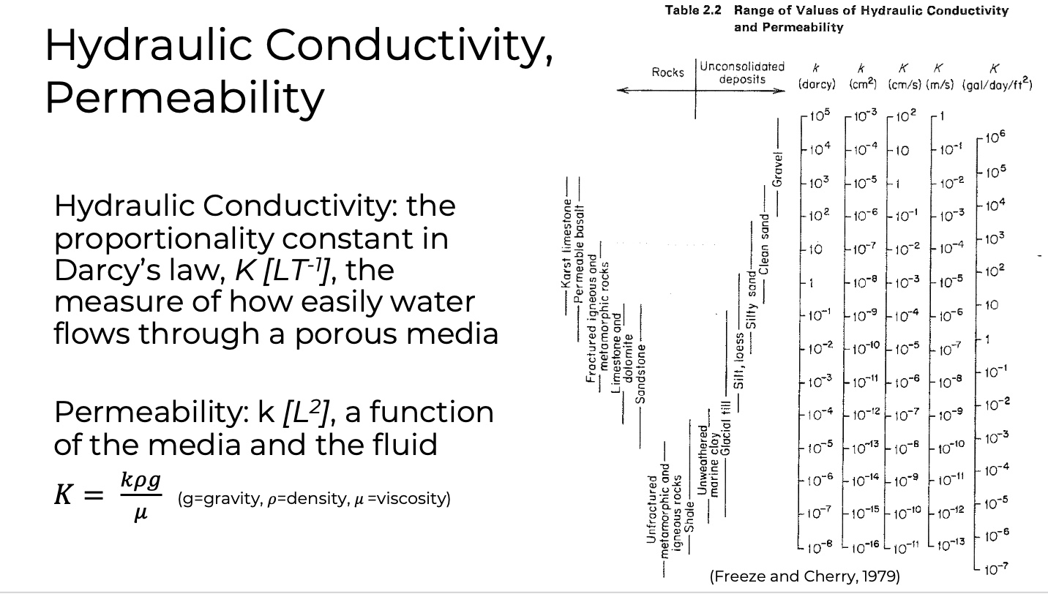
US Ne2 : Hydraulic Conductivity
The Hydraulic Conductivity that have been selected to run the simulations range between 10⁻¹³ and 1 m/s
The objective of running simulation on this big range is to assess the trend of the whole possible hydraulic conductivity through plotting . Moreover, the hydraulic conductivity with high values of error will be eliminated for the next round of simulation that will be more focusing on the range where the value of error are acceptable.

Slide 45
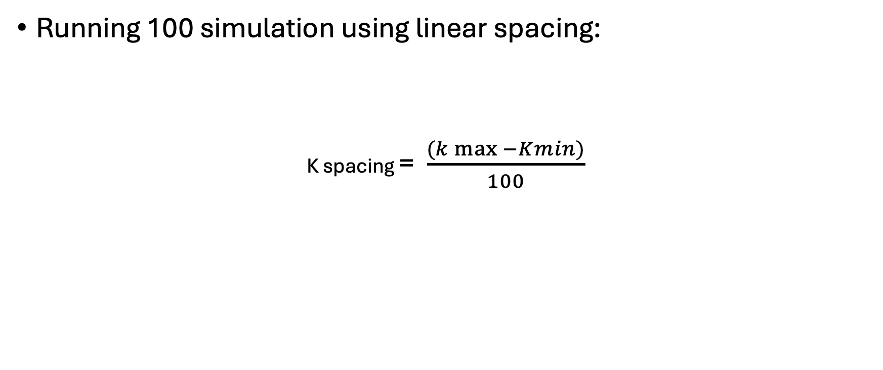
US-Ne2 : Simulation
Running 100 simulation using linear spacing:
K spacing = $\frac{(k\max{−Kmin)}}{100}$

Slide 46
US Ne2 : RMSE Test
The root mean square error test provides a single value that represents the difference in magnitude of the latent heat between the simulated and the observation in a one single value for each hydraulic conductivity. Moreover, it represents the trends or the pattern of error association with each k in our case.

Slide 47
Methodology
Running Simulation
Read The Data from the file
Filtering the data
Apply RMSE
Plotting
Running another Simulation

Slide 48
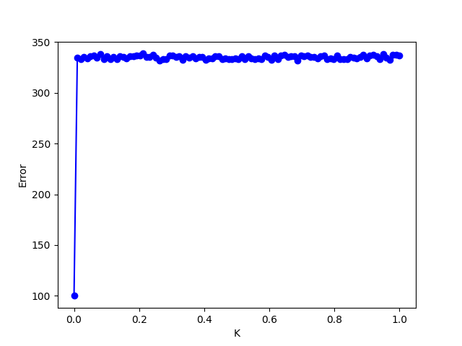
Plotting
Focus on the hydraulic conductivity values between 1.00E-13 and 0.01, as a pattern can be observed in this range of the graph while eliminate the other value when re-running the next simulation.

Slide 49
Proposed Approach
Focus on the hydraulic conductivity values between 1.00E-13 and 0.01, as a pattern can be observed in this range of the graph.
Divide this range into smaller intervals, as it is still quite large, and run 100 simulations for each interval.
Calculate the root mean square error (RMSE) for each interval. The prior distribution can then be plotted using the RMSE values.

Slide 50
Update Research 04 -12 -2024

Slide 51
Hydraulic Conductivity : Simulated vs Observed
Range of the k values
Kmin = 3.6 x 10⁻¹⁰ m/hr
Kmax = 3600 m/hr

Slide 52
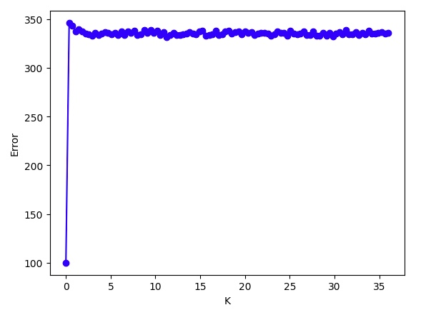
Hydraulic Conductivity : Simulated vs Observed
Range of the k values
Kmin = 3.6 x 10⁻¹⁰ m/hr
Kmax = 36 m/hr

Slide 53
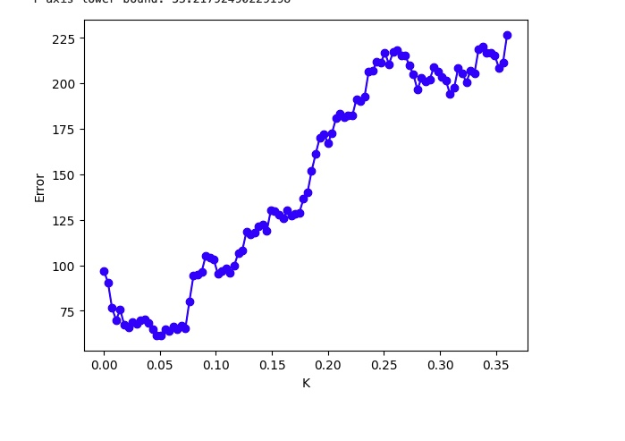
Hydraulic Conductivity : Simulated vs Observed
Range of the third simulation
Kmin = 3.6 x 10⁻¹⁰ m/hr
Kmax = 0.36 m/hr

Slide 54
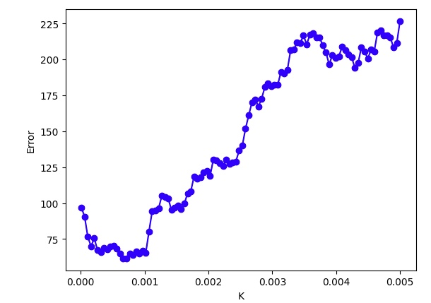
Hydraulic Conductivity : Simulated vs Observed
Range of the fourth simulation
Kmin = 0.00001 m/hr
Kmax = 0.005 m/hr

Slide 55
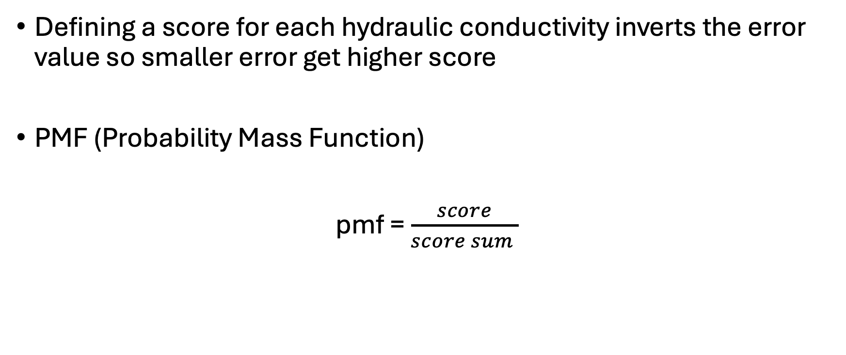
Prior Distribution
Defining a score for each hydraulic conductivity inverts the error value so smaller error get higher score
PMF (Probability Mass Function)
pmf = $\frac{score}{score sum }$

Slide 56
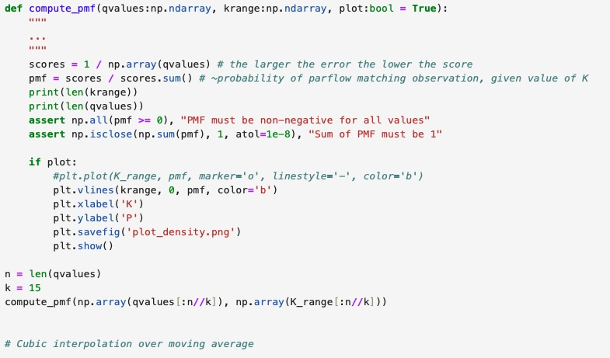
Prior Distribution Code

Slide 57
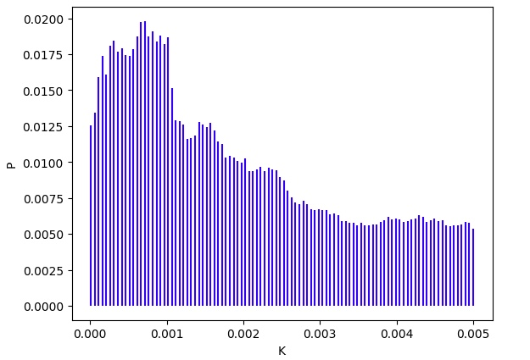
Fourth Simulation: Prior Distribution

Slide 58
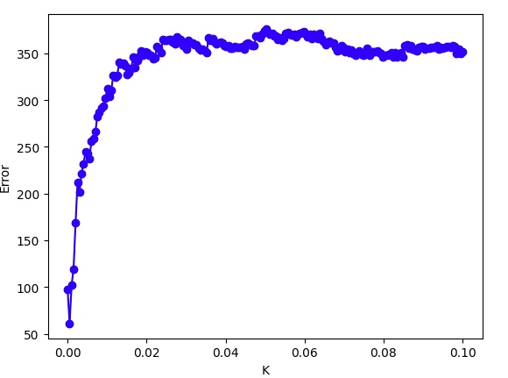
Hydraulic Conductivity
Kmin = 0.00001 m/hr
Kmax = 0.1 m/hr
simulation : 200

Slide 59
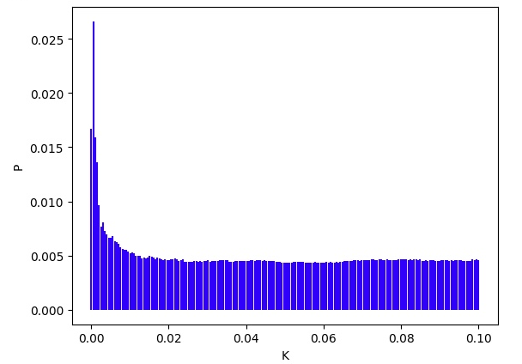
Prior Distribution

Slide 60
First Simulation
Second Simulation
Third Simulation
Fourth Simulation

Slide 61
Prior Distribution
Fourth Simulation
Fifth Simulation

Slide 62
Refining The Prior Distribution
To refine the prior distribution for hydraulic conductivity, it is essential to consider the results of the fourth and the fifth simulation where the error between the observation and the simulated data has been decreased significantly.
After determining the range of the hydraulic conductivity, we will increase the density of values withing the interval selected by running more simulations within this range.

Slide 63
Discussion of Baseline Condition
The prior distribution for hydraulic conductivity has been generated based on specific conditions, namely porosity and a define water table depth. The baseline conditions play a critical role in shaping the resulting prior distribution. If these conditions were altered –such as modifying the porosity or selecting water table depth – the resulting prior distribution for k could differ significantly.

Slide 64
Discussion of Soil Type
When discussing type of soil, it means that the focus on the environmental soil (bare soil , vegetated soil , soil with a specific land use) .

Slide 65
Discussion of Porosity for Baseline Condition
When starting the simulation to explore the impact of porosity , the baseline of hydraulic conductivity and water table depth should be the same as the baseline condition to ensure that any observed variations in the error is attributed solely to change in porosity .

Slide 66
Proposed Approach
Run the hydraulic conductivity simulation on a different HUC to determine if the pattern remains consistent but with a translation or shift in its behavior .

Slide 67
Update Research 18-12-2024

Slide 68
Hydrological Model Example
Trying to run the example provided by Dr. Peter Melchior to become familiar with creating virtual environment for SBI .

Slide 69
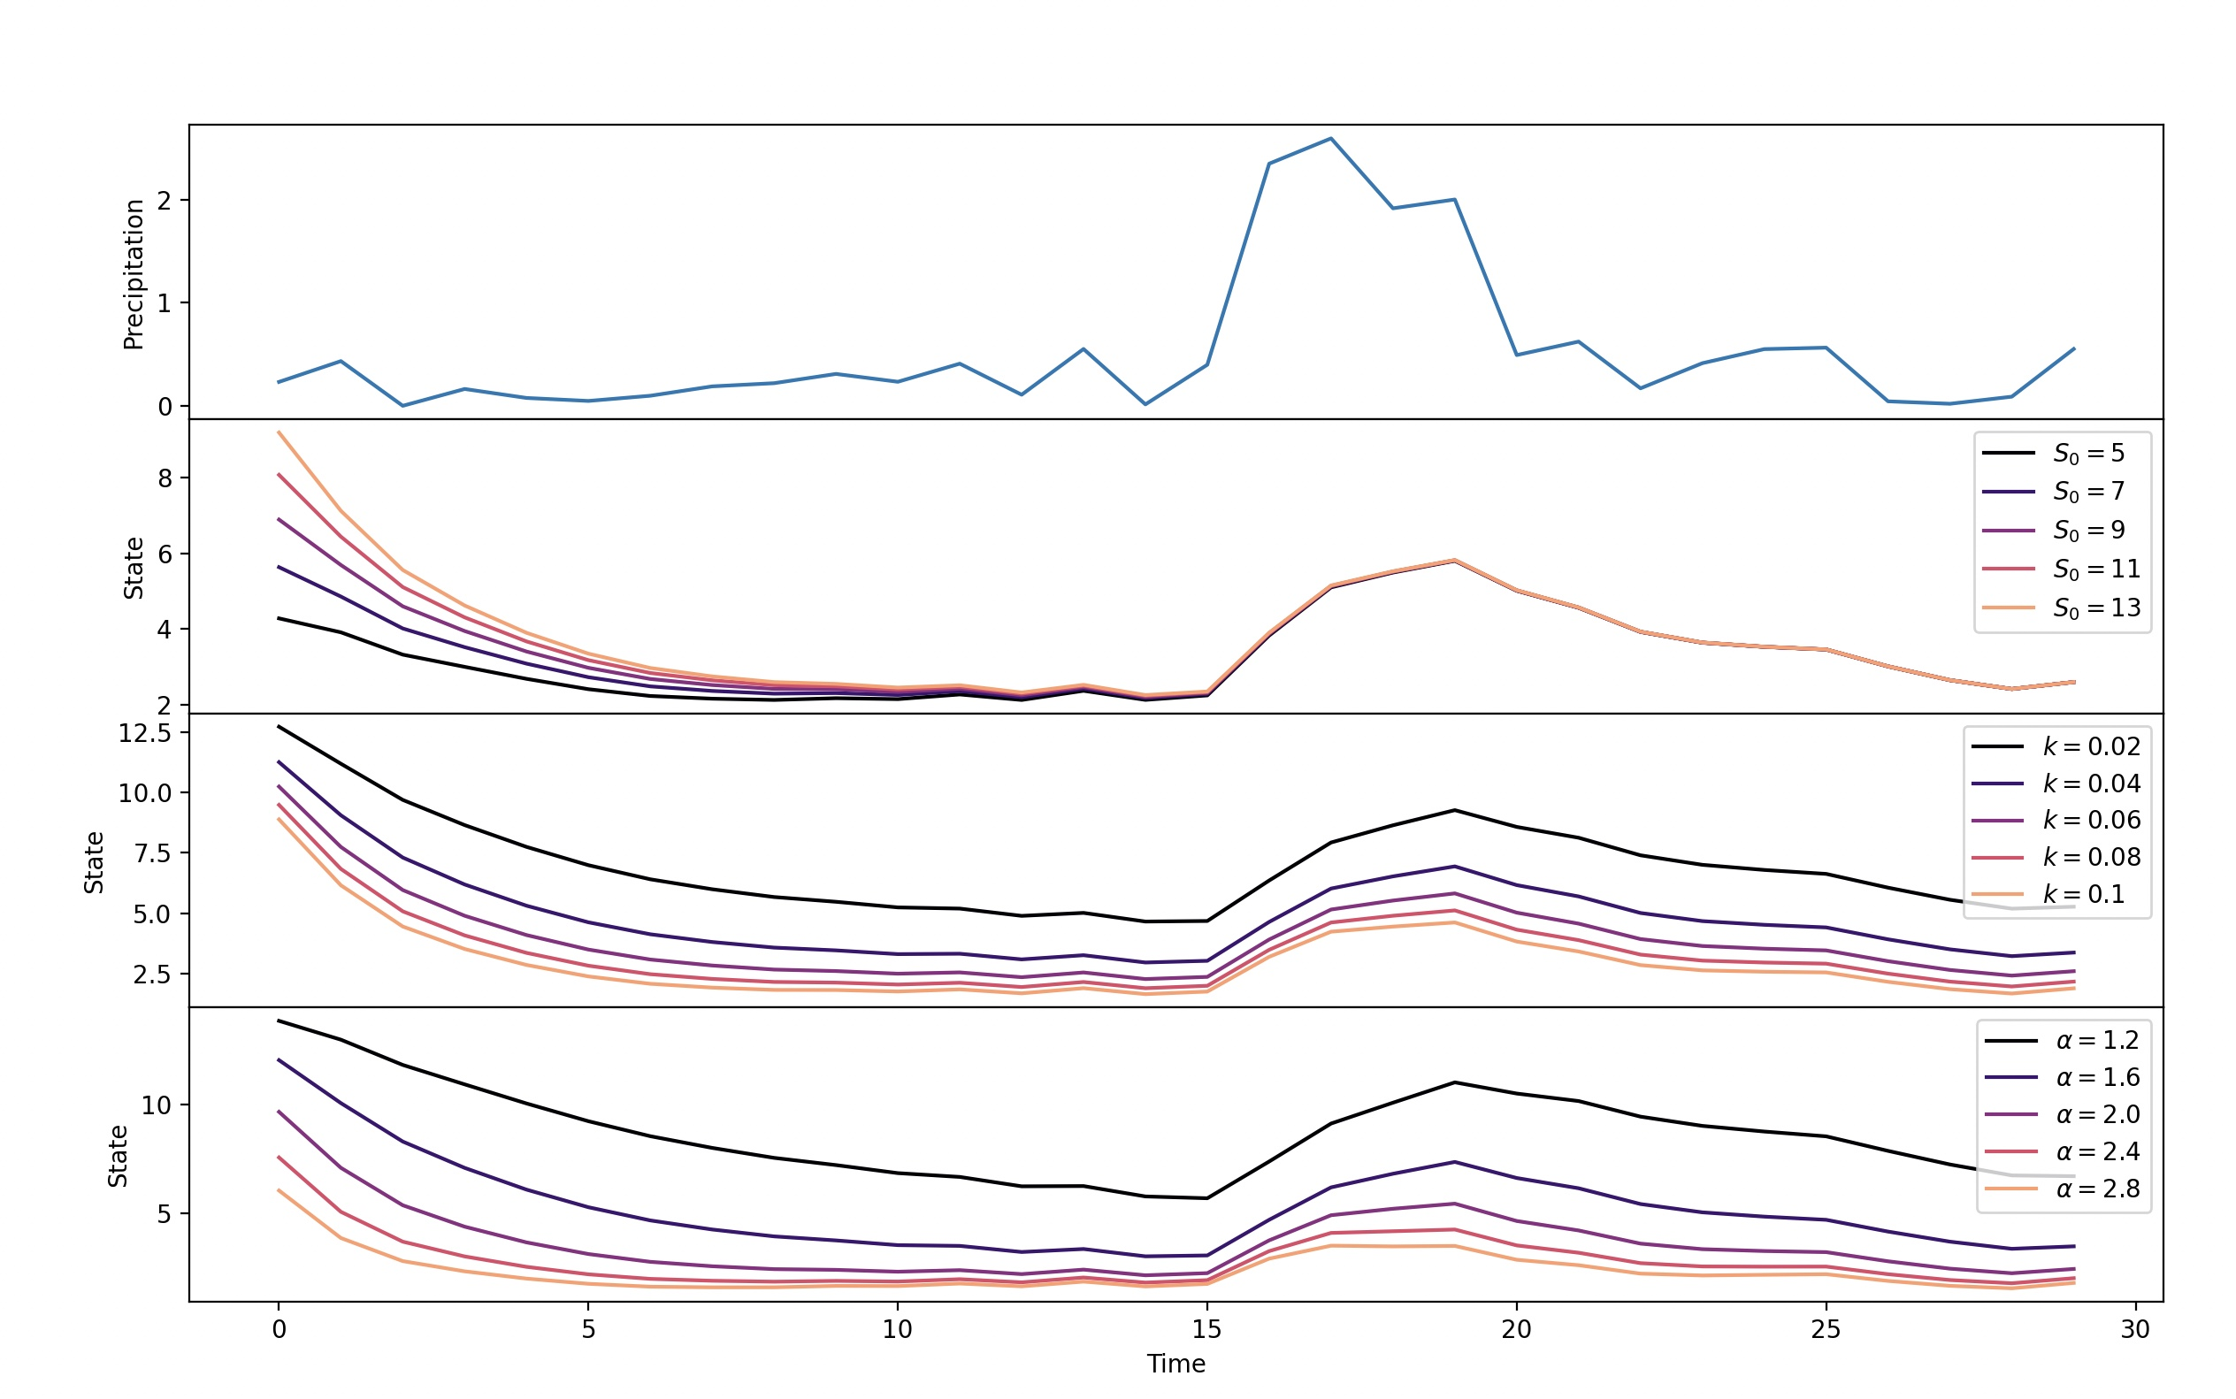
Outputs of the Example

Slide 70
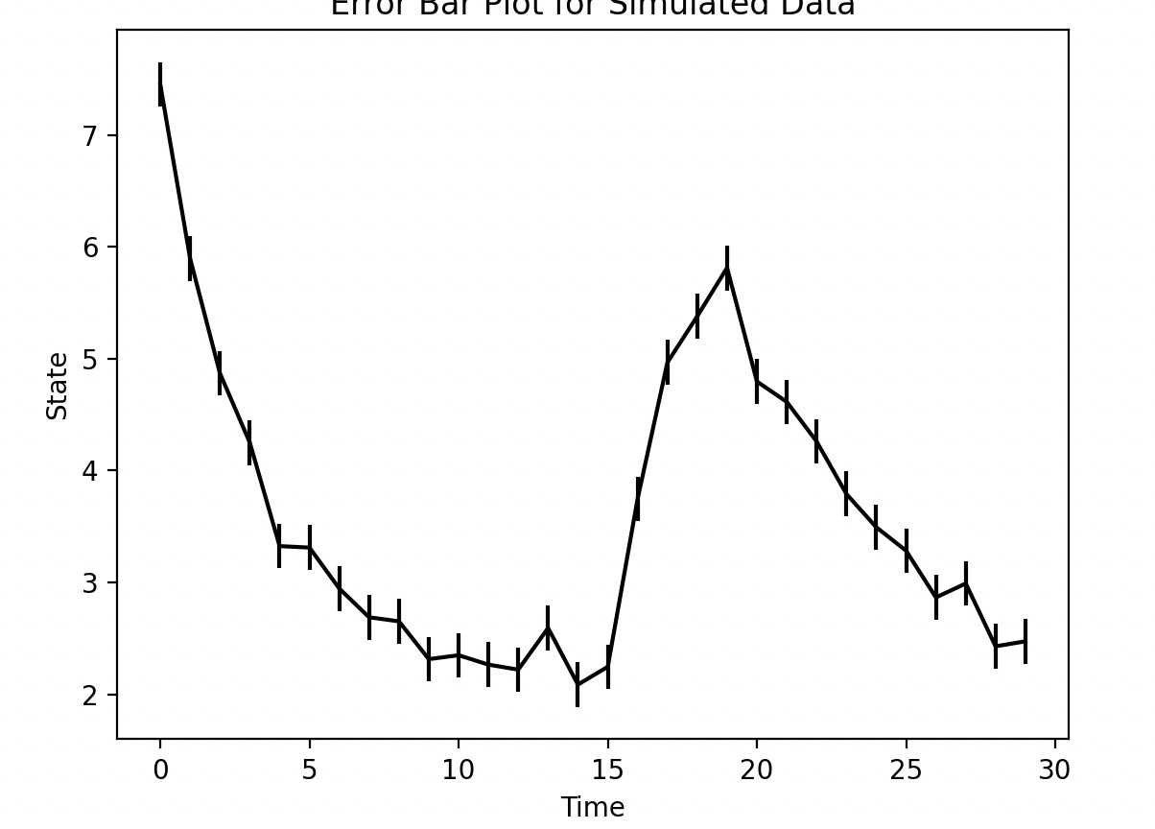
Outputs of the Example

Slide 71
Update Research 30- 01-2025

Slide 72
Objective
Run Amanda's workflow for her test problem: finding the true Manning's value, using the Baseline simulation's Manning's as the true value.

Slide 73
Summary :
Run the Baseline Simulation: Execute `setup_experiment.py` to generate the Baseline simulation, which serves as the true value for Simulation-Based Inference (SBI) . It is also used to generate the prior distribution which is assumed to be uniform for the first run of SBI.
Generate the Ensemble: Create an ensemble from the prior/posterior distribution, getting a CSV file with 100 rows, each containing a different Manning’s value.
Run Simulations on ParFlow: Use ParFlow to simulate data for each Manning’s value from the ensemble created.
Train the SBI Model: Train the SBI model using the simulated data and the prior distribution to obtain the posterior distribution, representing the conditional probability of the parameter given the observed data.

Slide 74
SBI Environment
hf_hydrodata>=1.0.8 rioxarray>=0.13.4 rasterio>=1.3.9
subsettools>=1.0.3 jupyter>=1.0.0 ipykernel>=5.3.2
scikit-learn>=1.4.0 pytest-mock>=3.12.0. pytest>=8.0.0
pyshp>=2.3.1 pylint>=3.0.3 Pillow>=10.2.0
pftools>=1.3.10 pandas>=2.2.0 matplotlib>=3.8.2
black>=24.1.1 geopandas>=0.14.2 seaborn>=0.13.2
openpyxl>=3.1.5 s3fs>=2024.6.1
conda install -c conda-forge python=3.10 pip
conda install pytorch pytorch-cuda=12.4 -c pytorch -c nvidia

Slide 75
Github Repository
git@github.com:ms6730/Updated-Version-SBI-.git
https://github.com/ms6730/Updated-Version-SBI-.git

Slide 76
Github repository
The GitHub repository contains a README.md file that outlines all the necessary steps to run the scripts and train the model. Additionally, it documents the modifications made to the scripts.

Slide 77
Simulation Based Inference

Slide 78
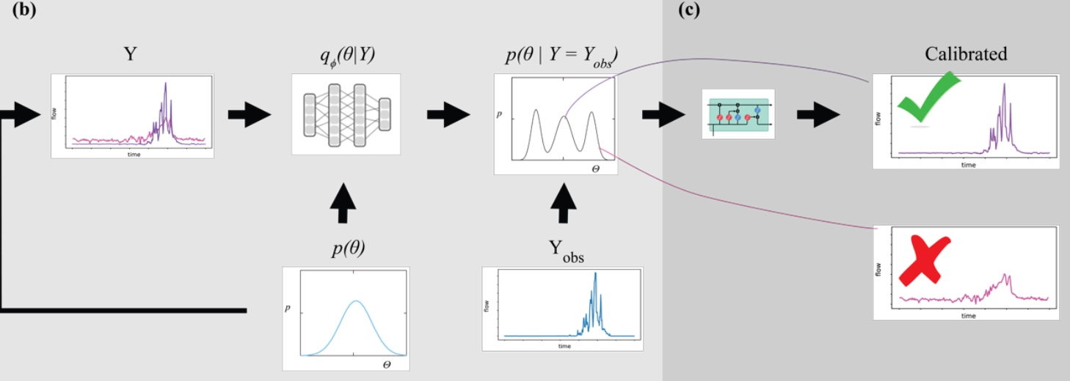
Simulation Based Inference
Validation
Validation

Slide 79
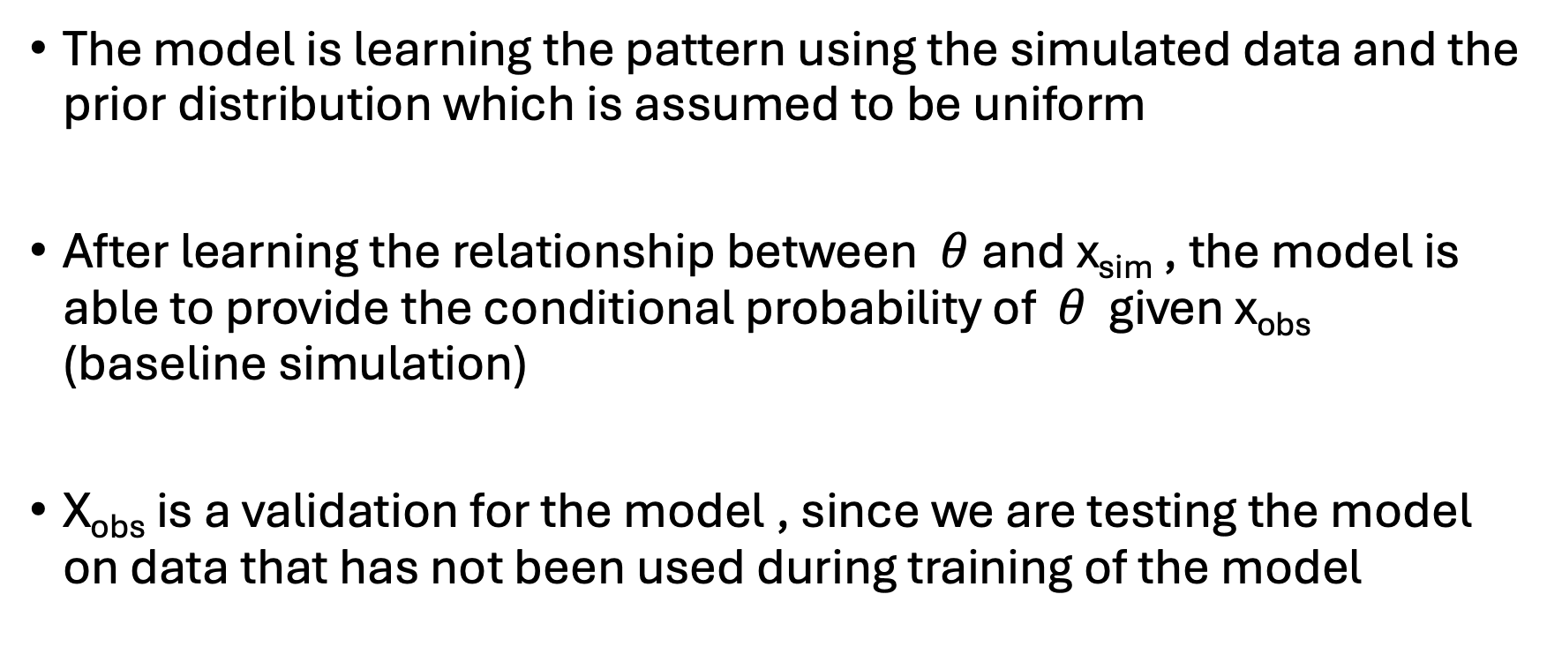
Validation : Observed data (Baseline Simulation)
The model is learning the pattern using the simulated data and the prior distribution which is assumed to be uniform
After learning the relationship between $θ$and x_{sim} , the model is able to provide the conditional probability of $θ$ given x_{obs} (baseline simulation)
X_{obs} is a validation for the model , since we are testing the model on data that has not been used during training of the model

Slide 80
Results

Slide 81
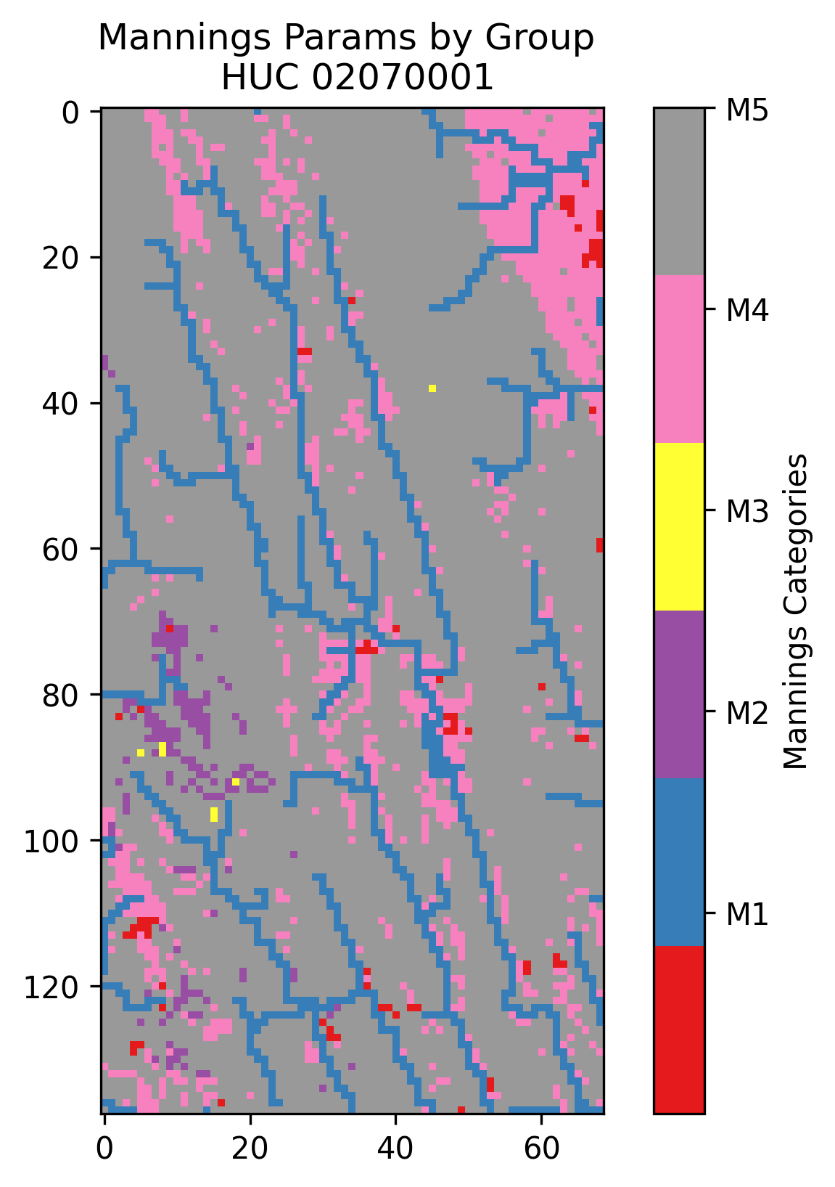
HUC : 02070001

Slide 82
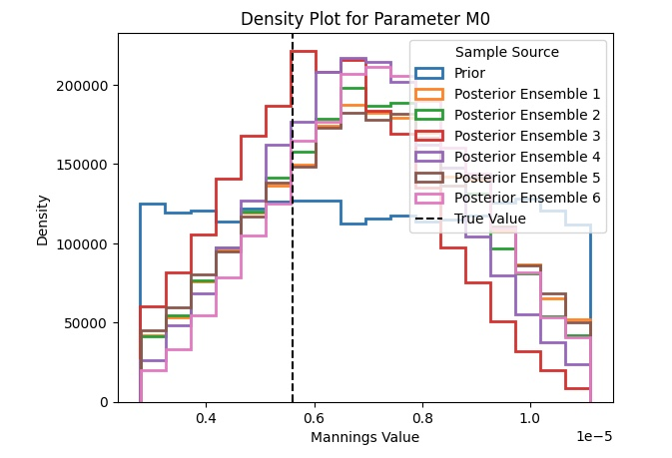
Density Plot for M₀

Slide 83
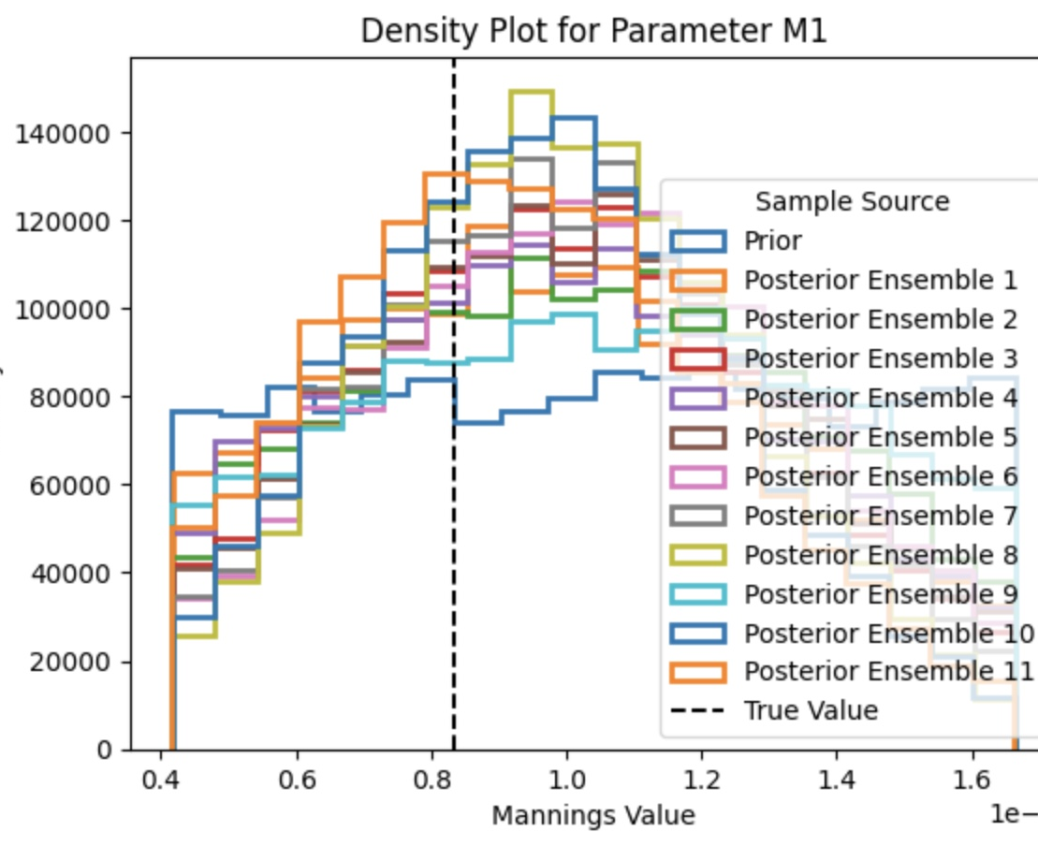
Density plot for M₁

Slide 84
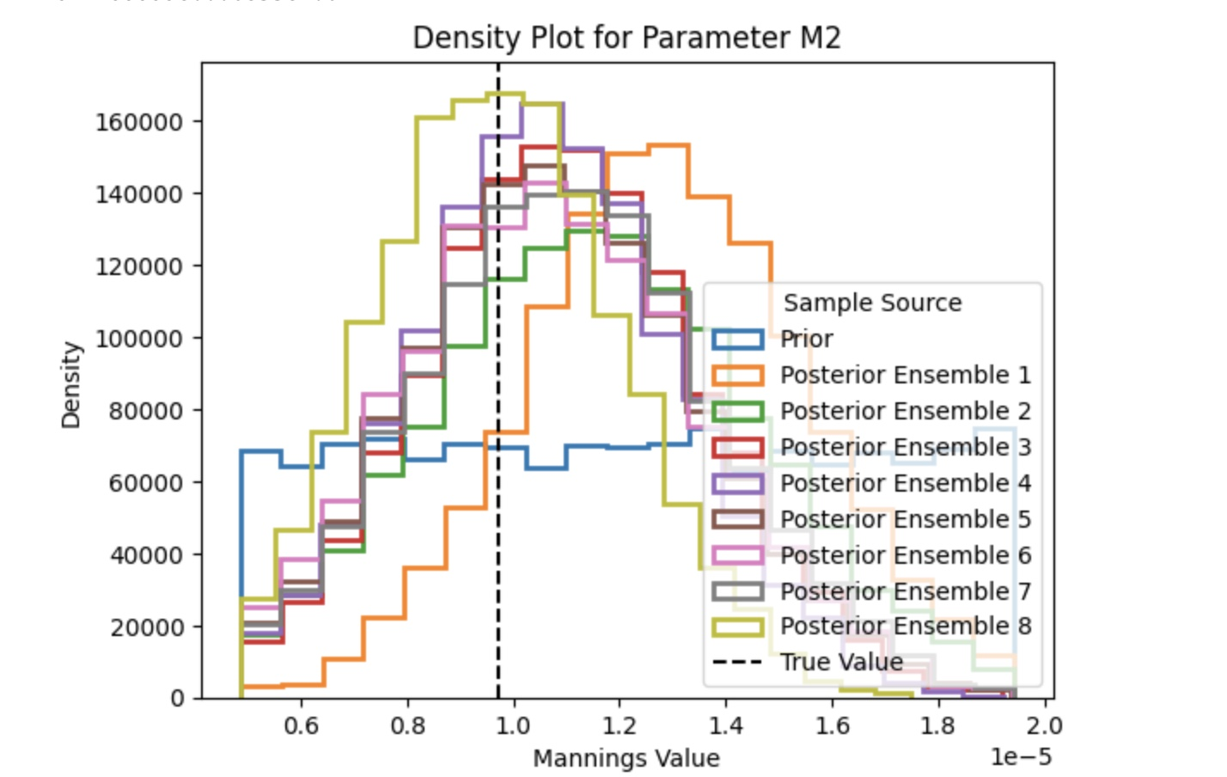
Density plot for M₂

Slide 85
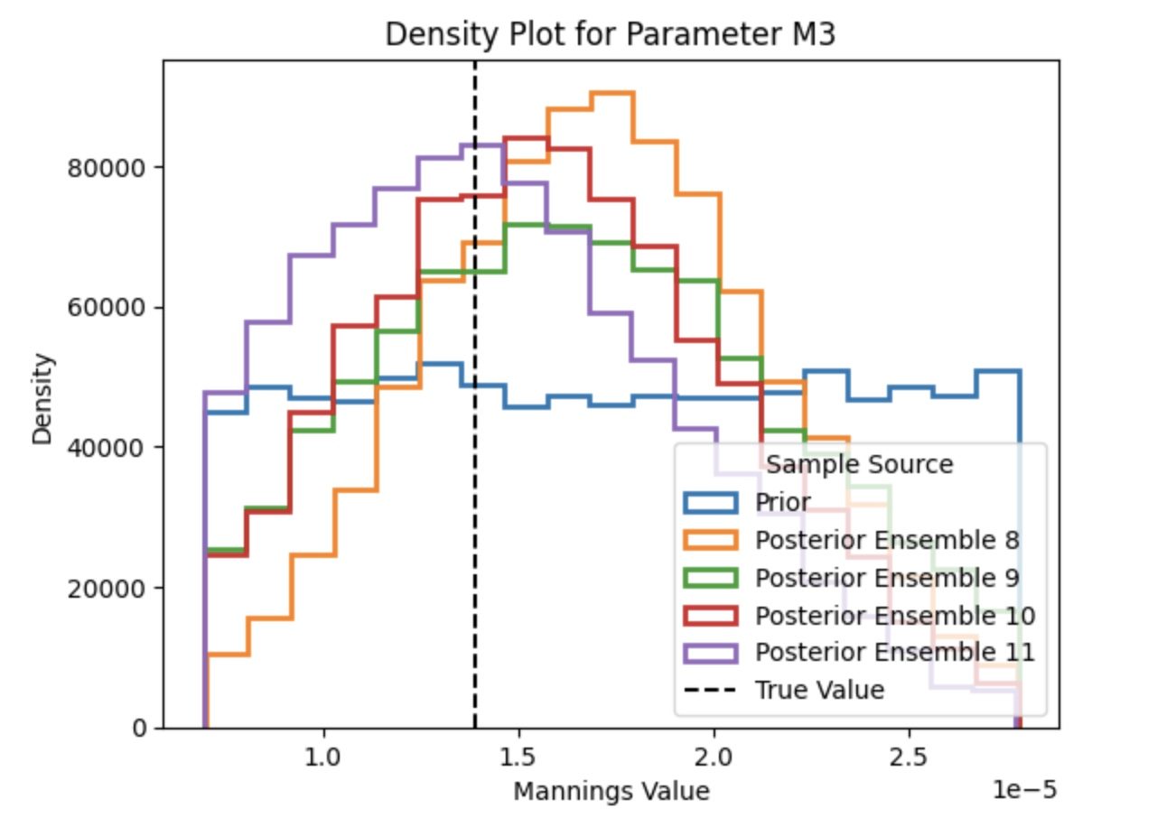
Density plot for M₃

Slide 86
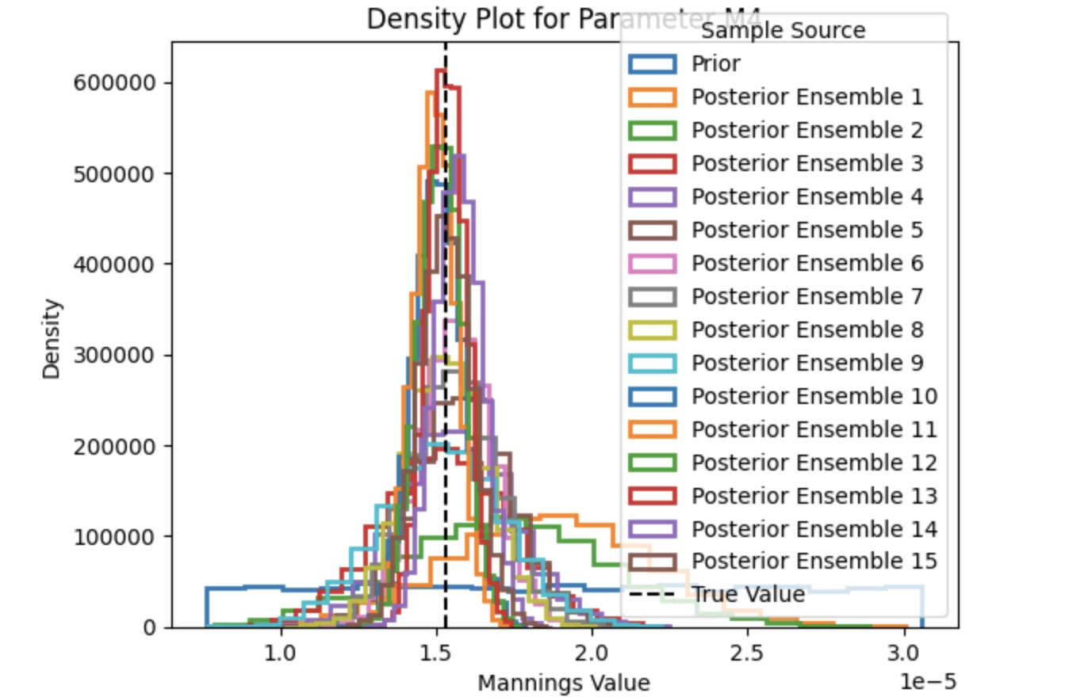
Density plot for M₄

Slide 87
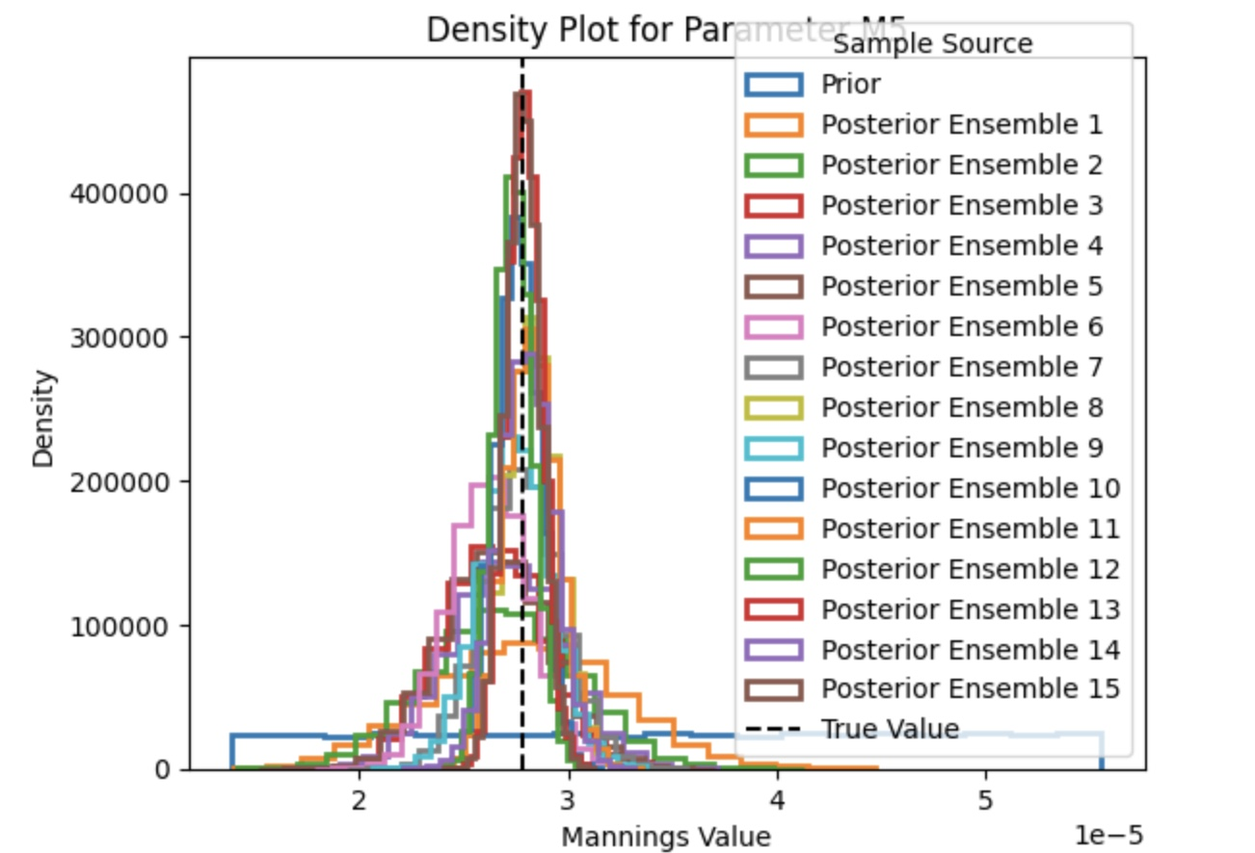
Density plot for M₅

Slide 88
Update Research 20 – 02 -2025

Slide 89
Reading Papers
‘A High Resolution, 3D groundwater-surface water simulation of the contiguous US: Advances in the integrated ParFlow CONUS 2.0 modeling platform’
‘The frontier of simulation-based inference ’
Subsettools Catalog

Slide 90
A High Resolution, 3D groundwater-surface water simulation of the contiguous US: Advances in the integrated ParFlow CONUS 2.0 modeling platform
Difference between CONUS 1 and CONUS 2 domain
Two spinup phase
ParFlow Numerical Solution Approach
E-Folding Approach
Van Genuchten Parameters
Region (D1) and Region (D2)
Discrete Soil Texture

Slide 91
A High Resolution, 3D groundwater-surface water simulation of the contiguous US: Advances in the integrated ParFlow CONUS 2.0 modeling platform
ParFlow Equations
Setting Initial Conditions (Spinup phase)
No-Flow boundary conditions
Seepage condition
Ratio of RMSE to Standard deviation
Importance of Log Transformation
Hydraulic head vs Water Table Depth

Slide 92
Subsettools
Forcing dataset: CW3E and NLDAS2
Transient run vs steady state run
Sources of Static Input Data
PF-CLM run
ParFlow standalone
Subset Domain functions
Static Data functions
Forcing Data functions

Slide 93
The Frontier of simulation–based inference
Traditional Method
Approximate Baysian Computation with Monte Carlo Sampling
Approximate Baysian Computation with learned summary statistics

Slide 94
Update Research 6 March 2025

Slide 95
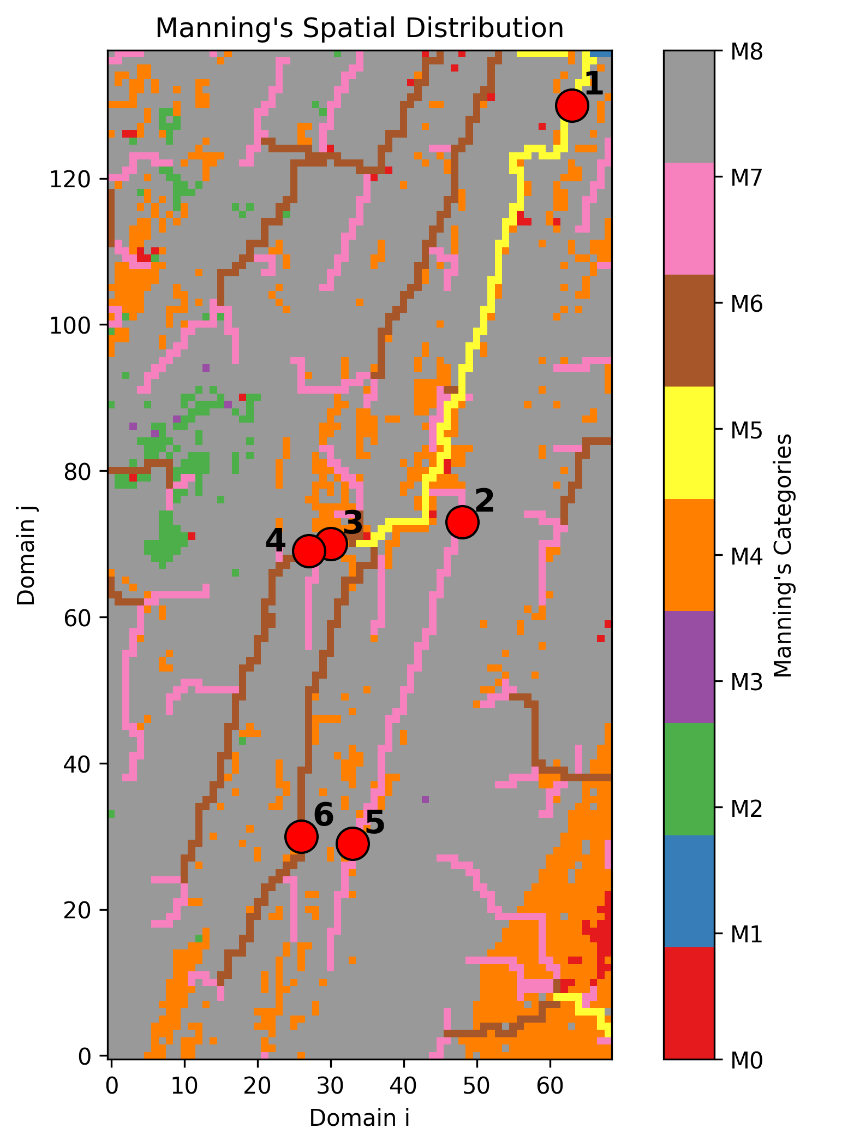
HUC 02070001

Slide 96
Objective
Getting The Posterior Density Estimation for the Manning’s given that the observed is the streamflow from Hydrodata

Slide 97
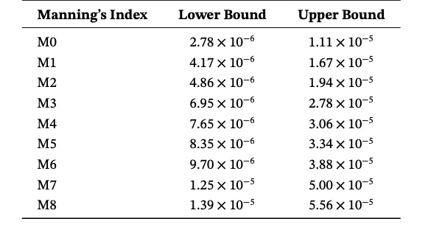
Prior Distribution
The prior distribution is initially defined as a uniform distribution, constructed based on Manning’s values derived from the static input data.
Its range is determined as follows:
The lower bound is set as the Manning’s value divided by a scalar of 2.
The upper bound is set as the Manning’s value multiplied by 2.

Slide 98
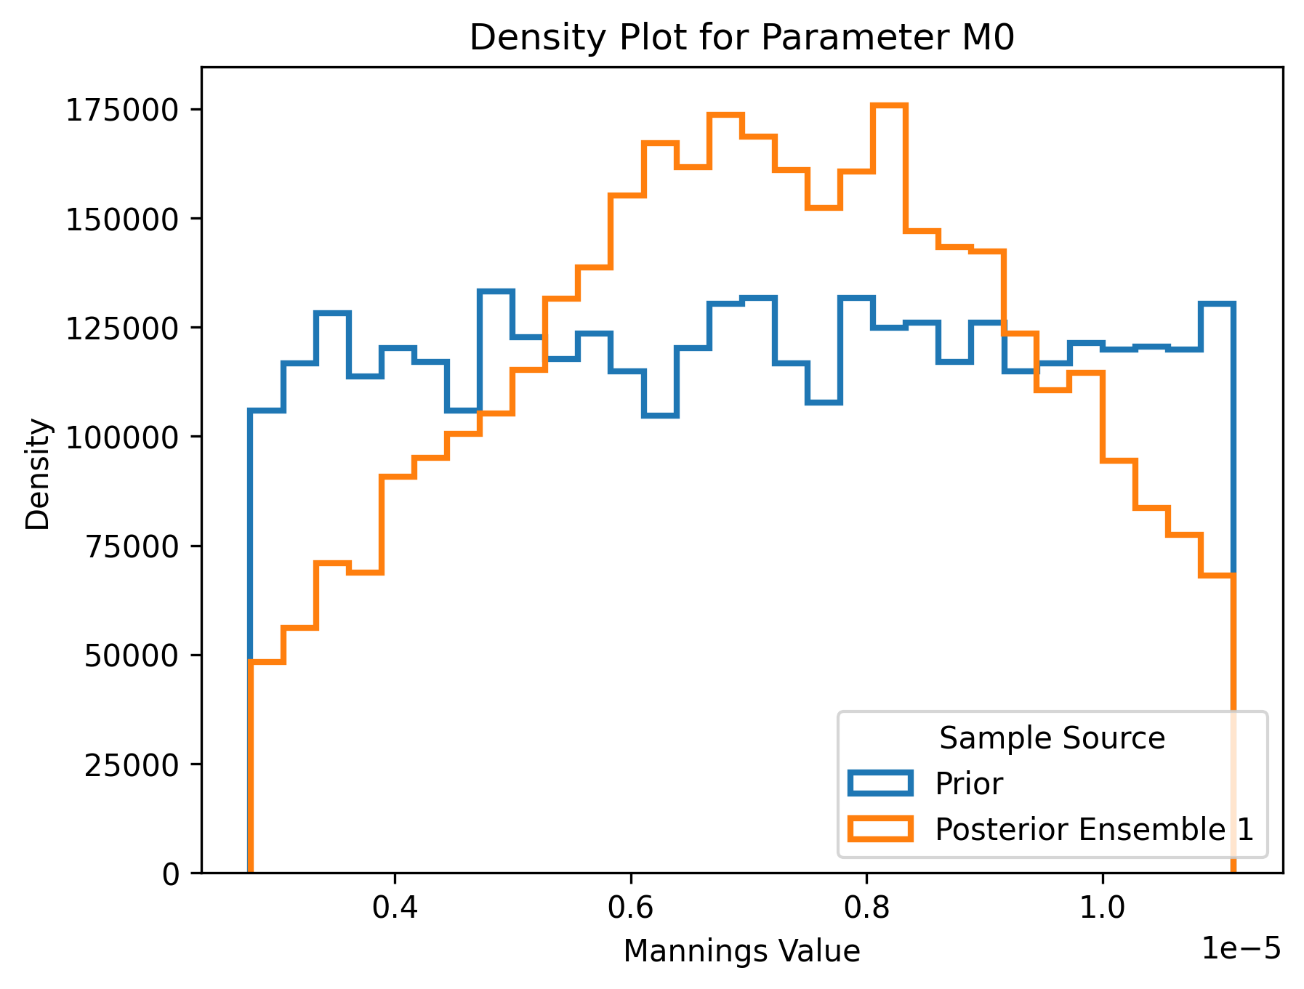
M0: Posterior Distribution
Notes:
Not

Slide 99
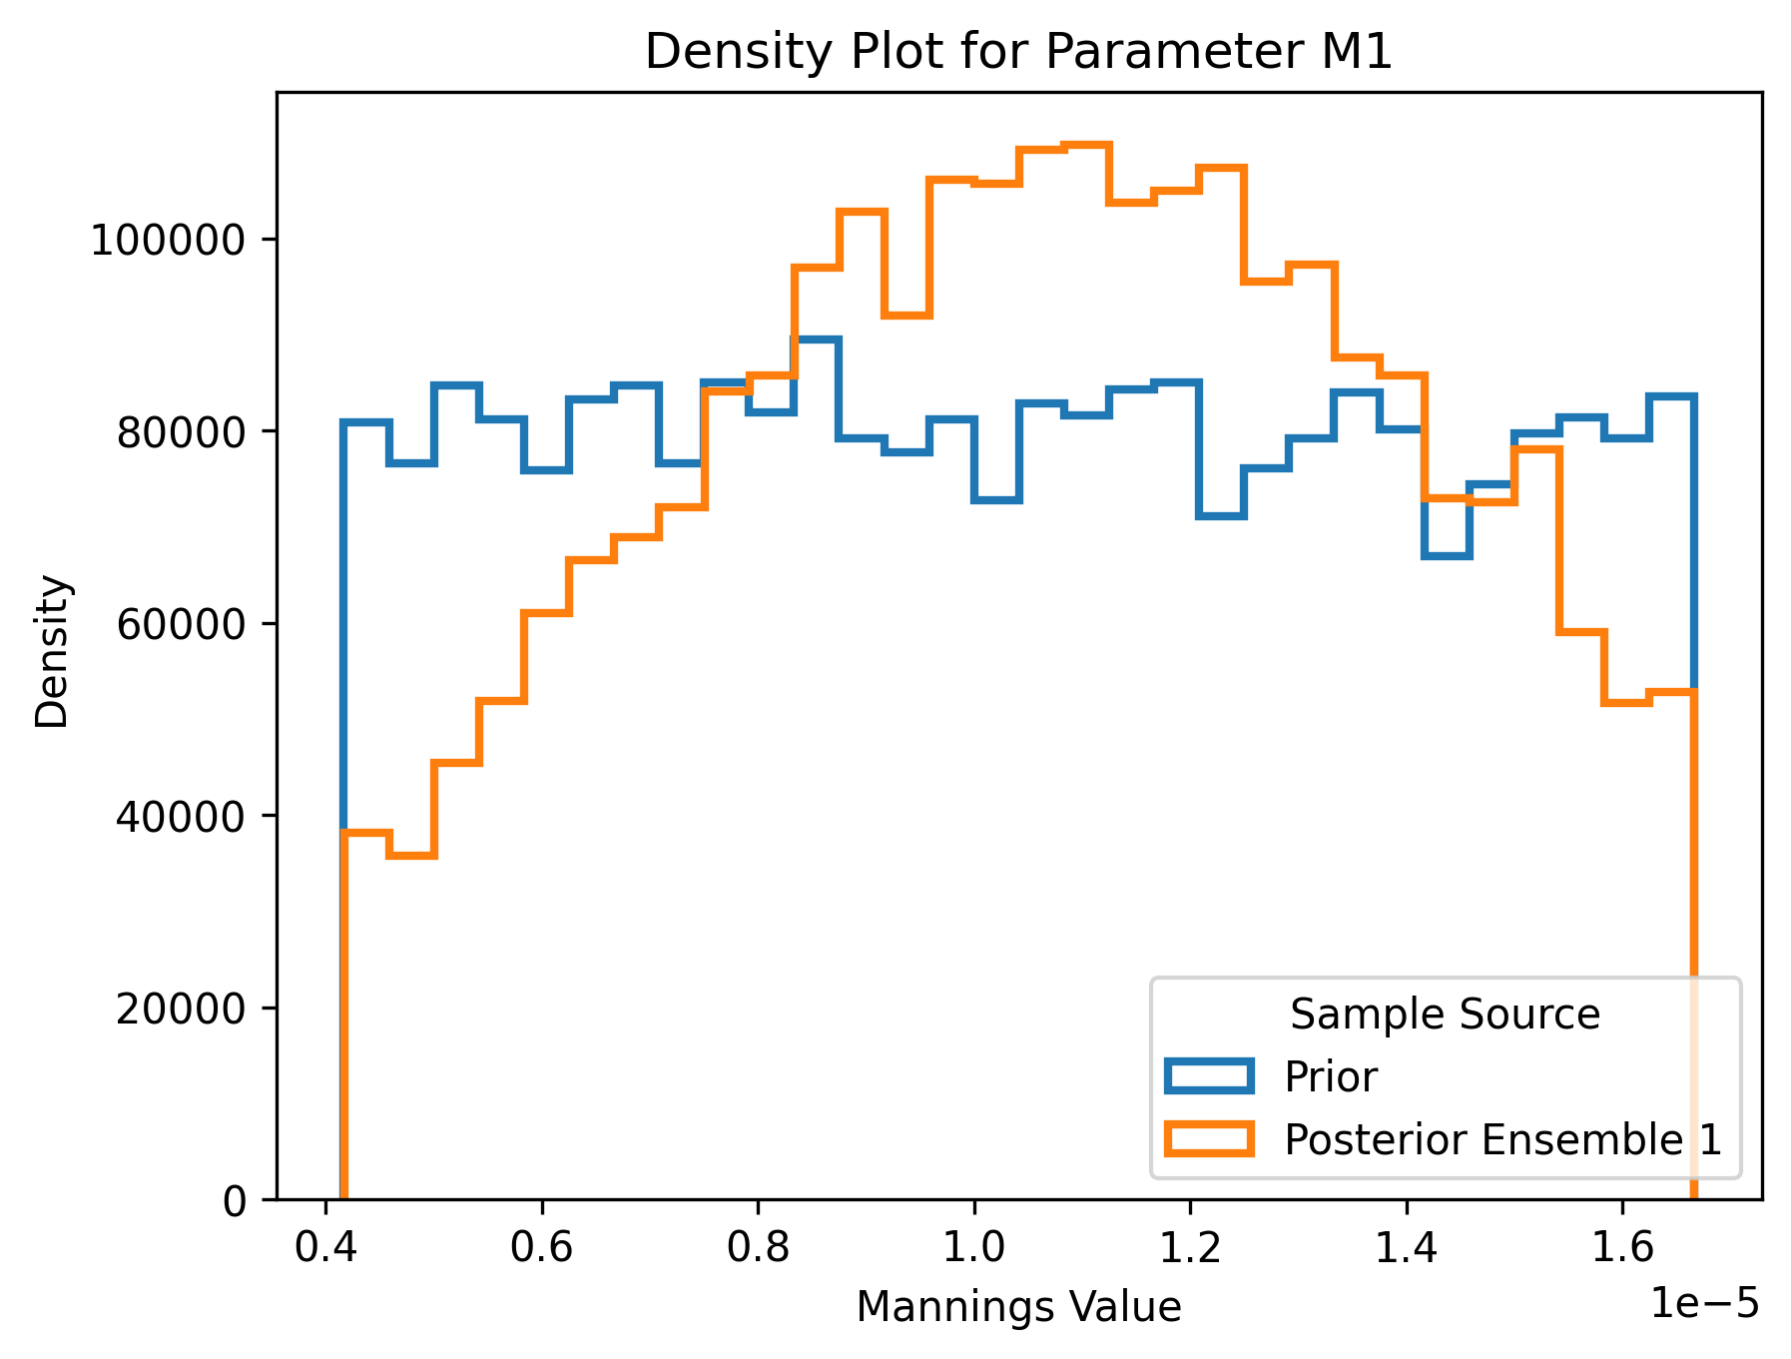
M1: Posterior Distribution
Notes:
Sampling 400 simulations
Posterior distribution that is presented is from the first iteration

Slide 100
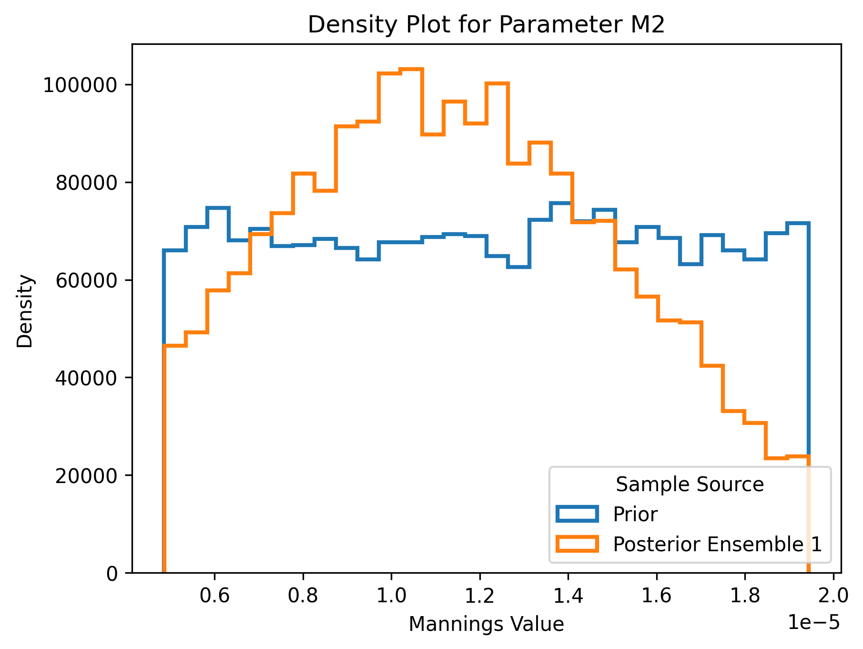
M2: Posterior Distribution
Notes:
Sampling 400 simulations
Posterior distribution that is presented is from the first iteration

Slide 101
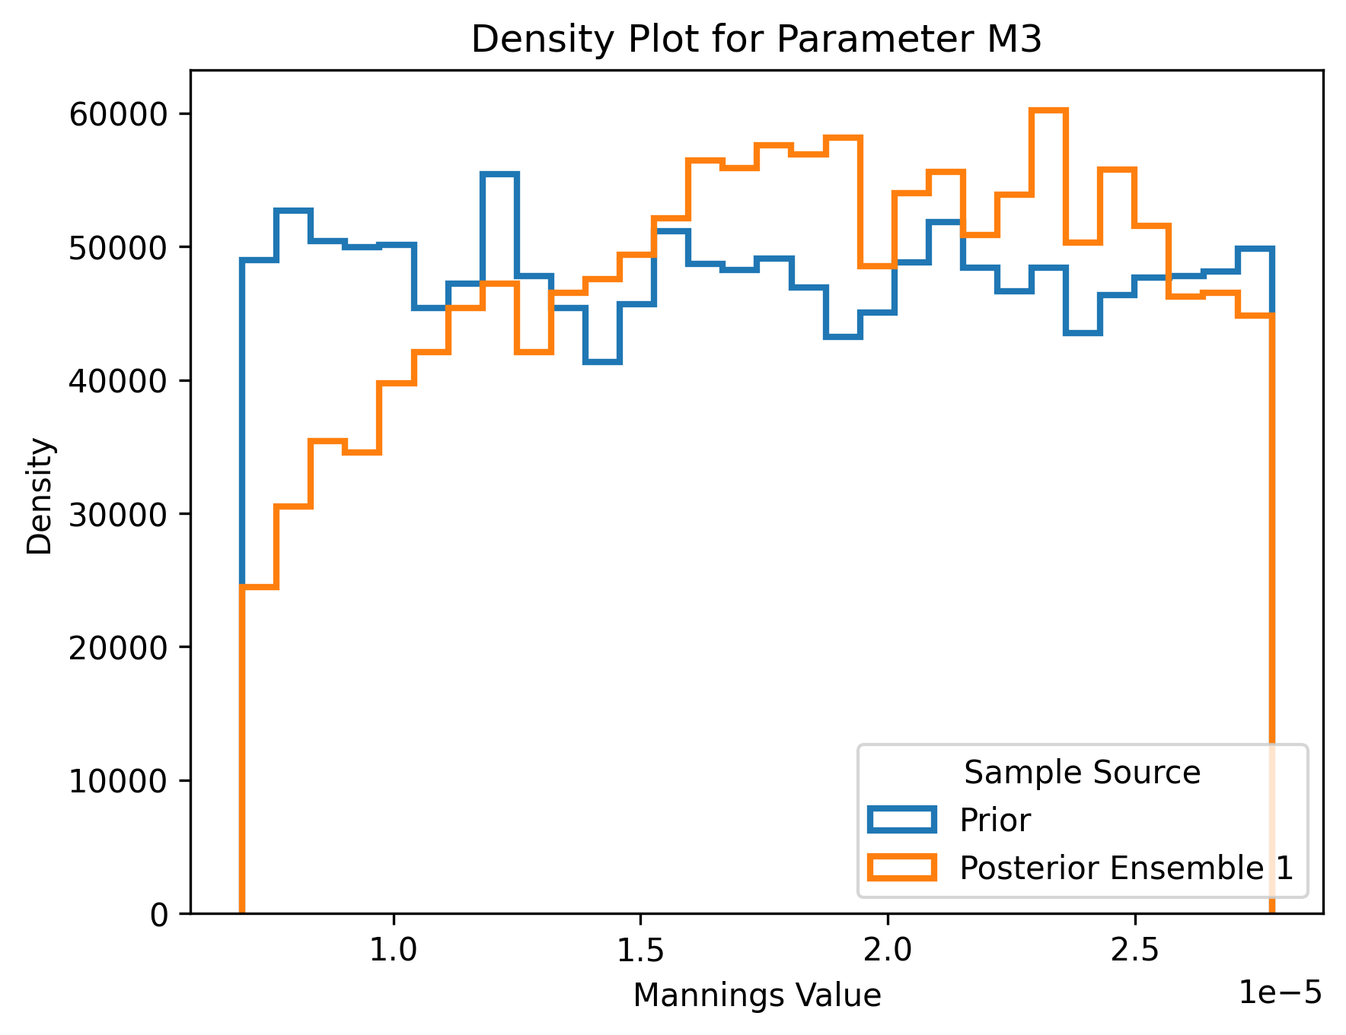
M3: Posterior Distribution
Notes:
Sampling 400 simulations
Posterior distribution that is presented is from the first iteration

Slide 102
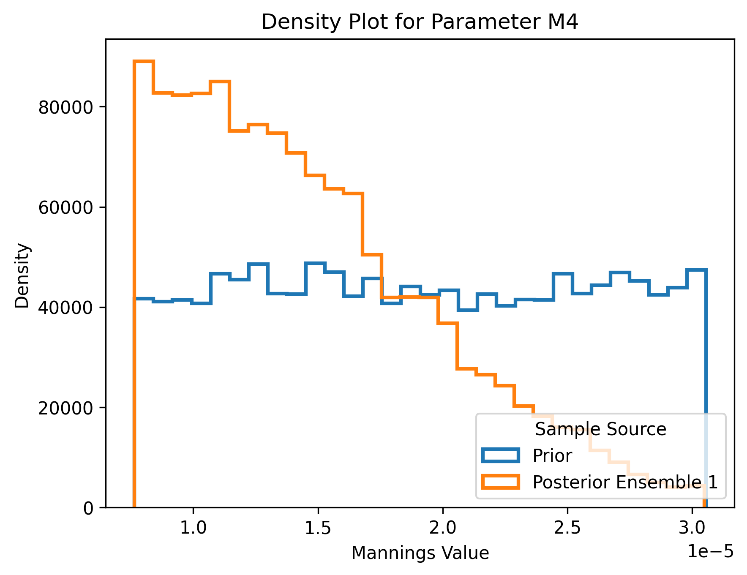
M4: Posterior Distribution
Notes:
Sampling 400 simulations
Posterior distribution that is presented is from the first iteration

Slide 103
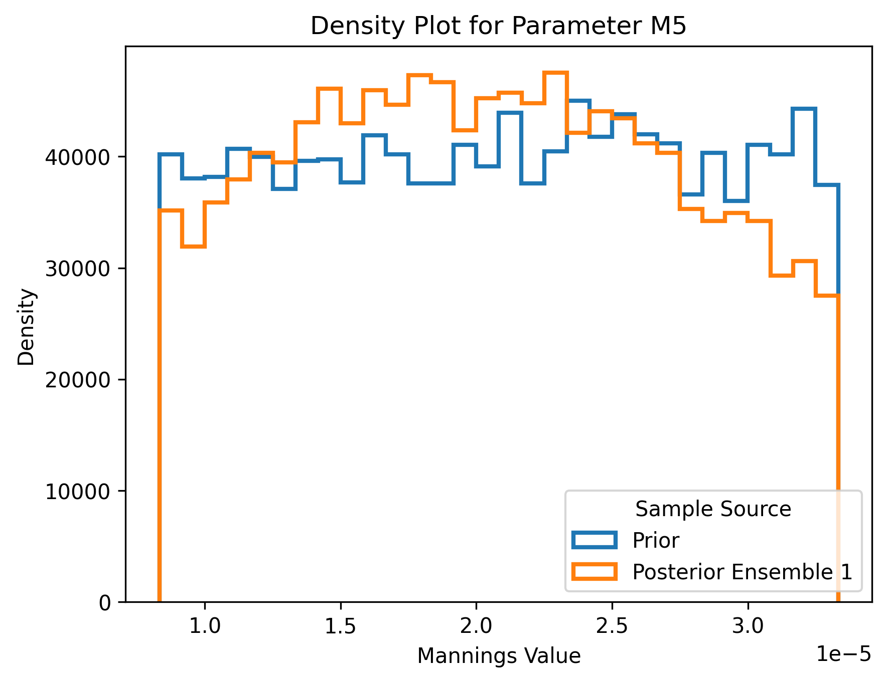
M5: Posterior Distribution
Notes:
Sampling 400 simulations
Posterior distribution that is presented is from the first iteration

Slide 104
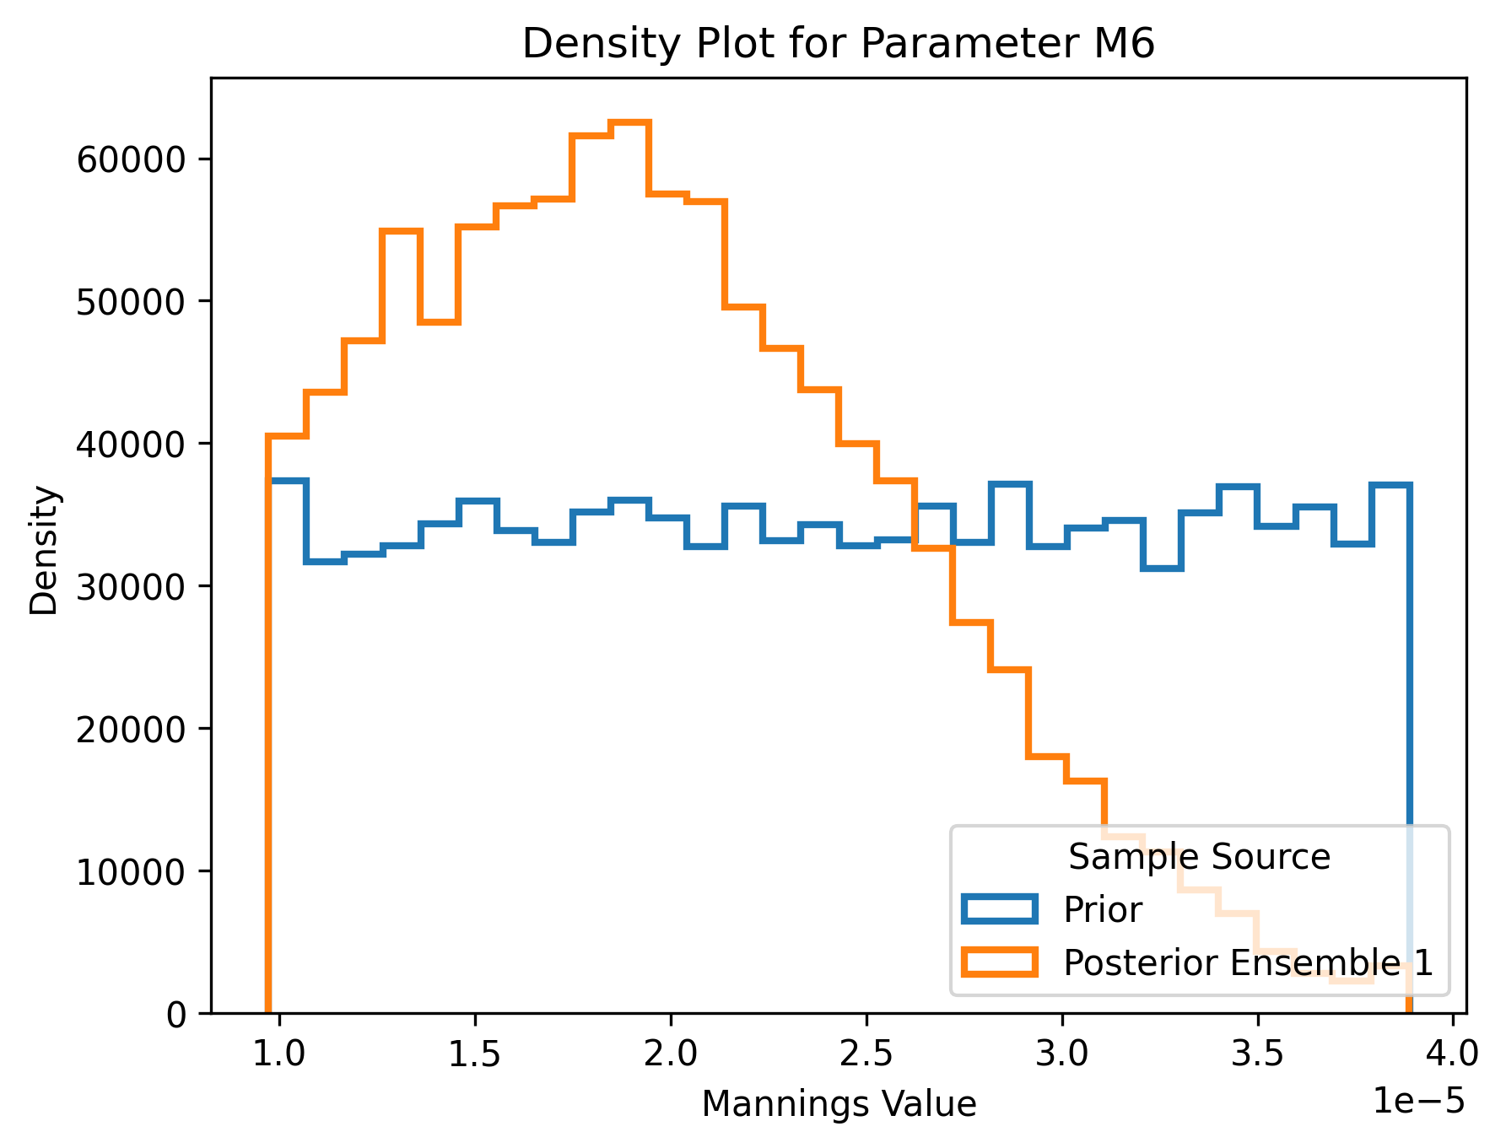
M6: Posterior Distribution
Notes:
Sampling 400 simulations
Posterior distribution that is presented is from the first iteration

Slide 105
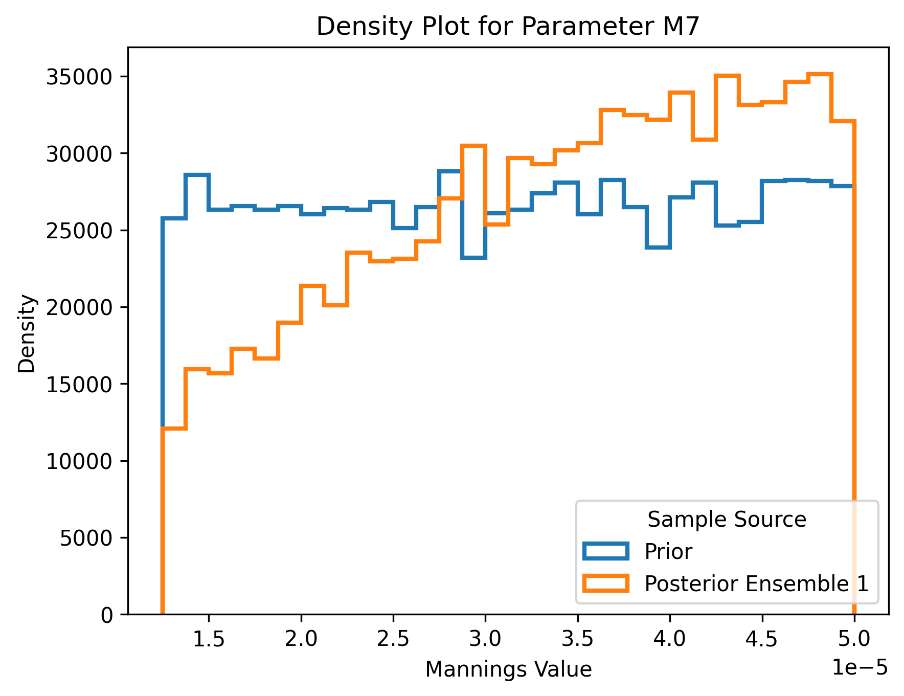
M7: Posterior Distribution
Notes:
Sampling 400 simulations
Posterior distribution that is presented is from the first iteration

Slide 106
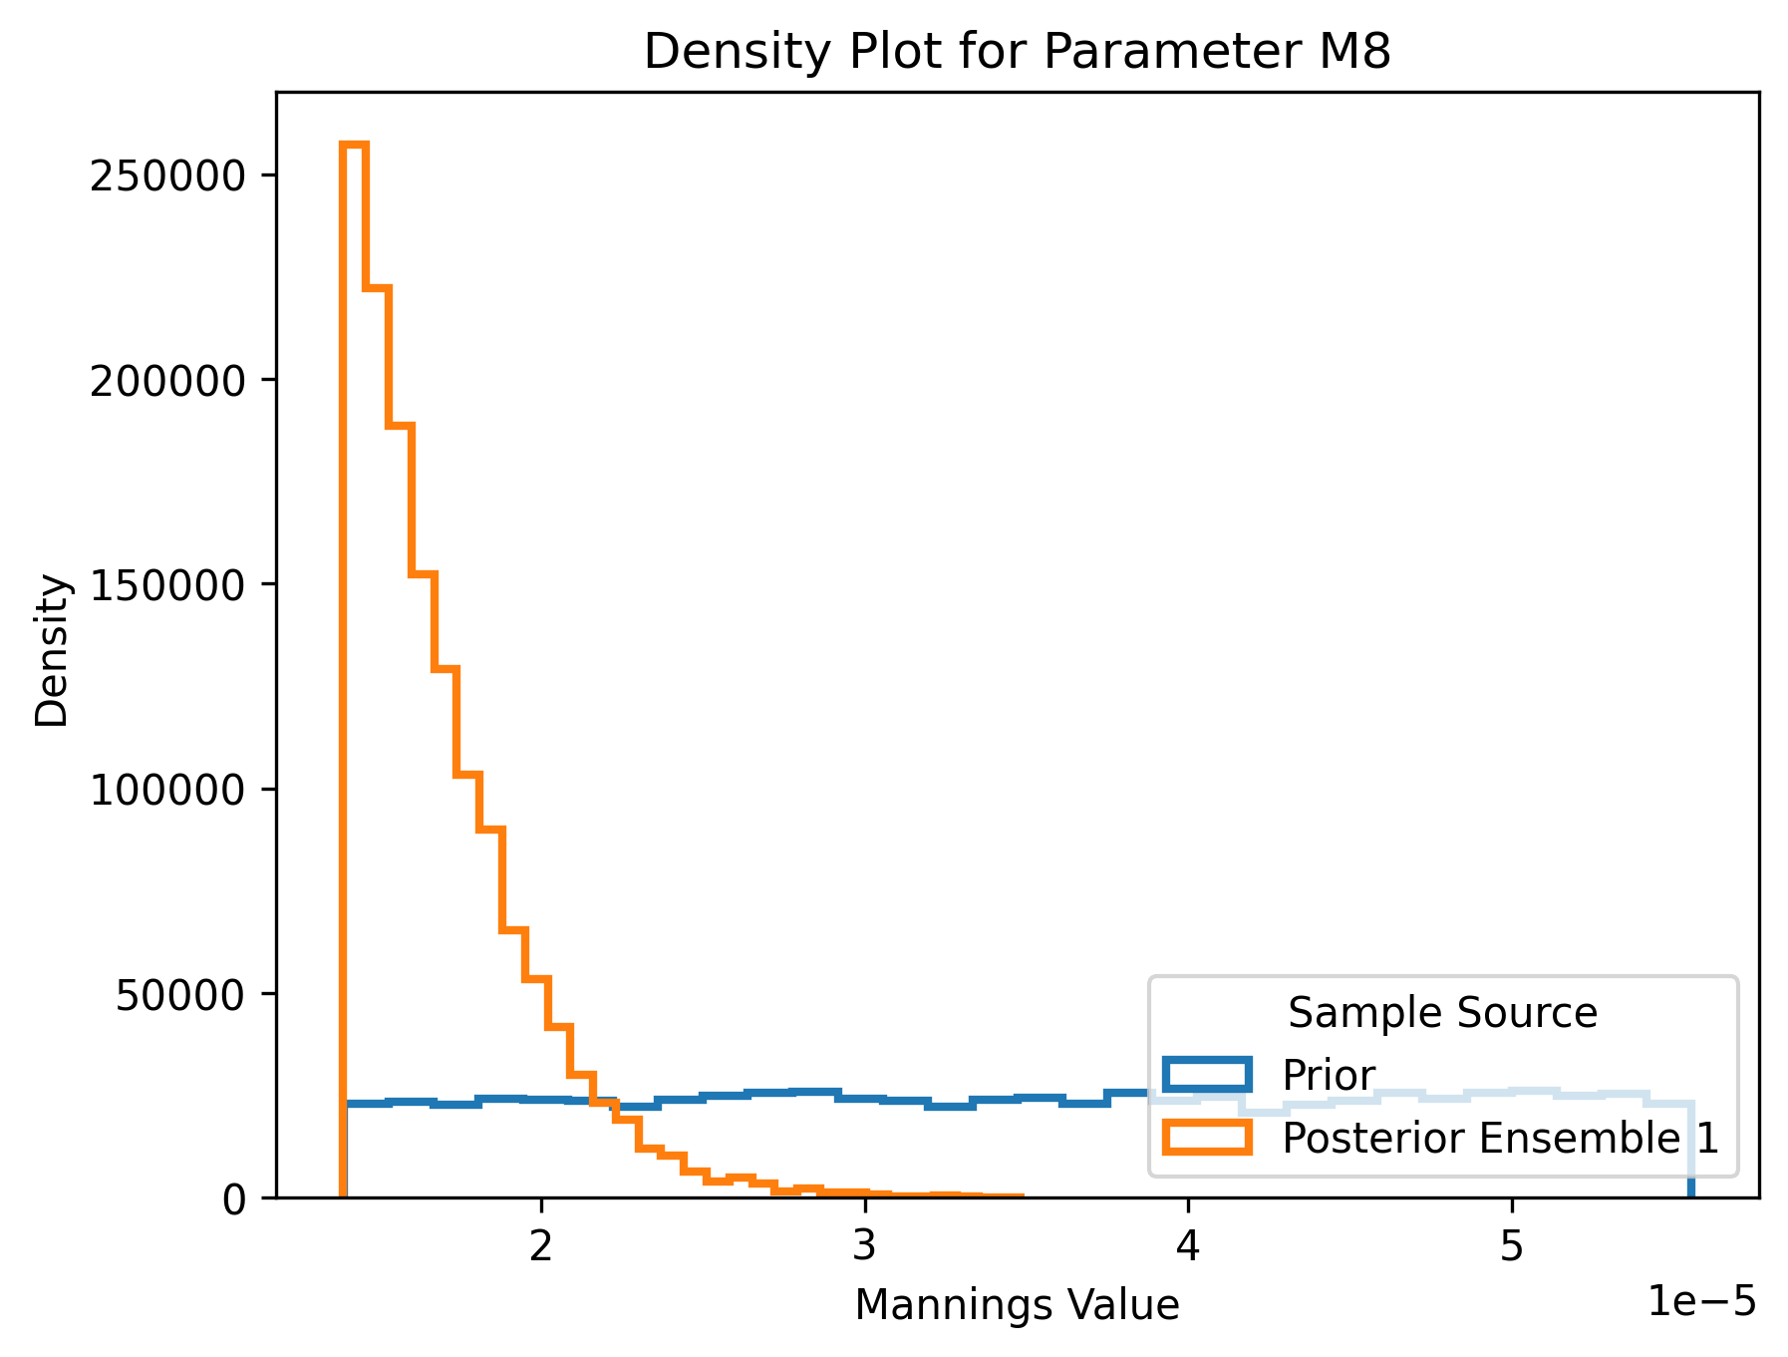
M8: Posterior Distribution
Notes:
Sampling 400 simulations
Posterior distribution that is presented is from the first iteration

Slide 107
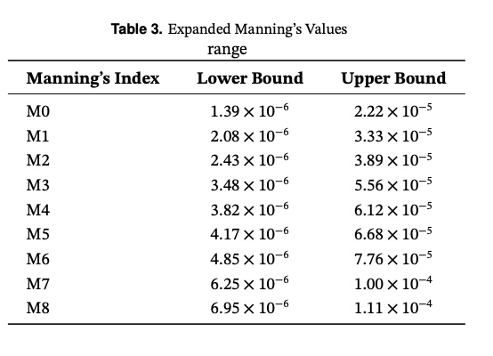
Calibrating The Prior Distribution
To expand the boundaries and facilitate broader exploration of the parameter, the scalar has now been increased to 4.
This adjustment effectively doubles the prior range, ensuring a more comprehensive coverage of possible Manning’s values and enhancing the flexibility of the model.

Slide 108
After Calibrating the prior ditstribution

Slide 109
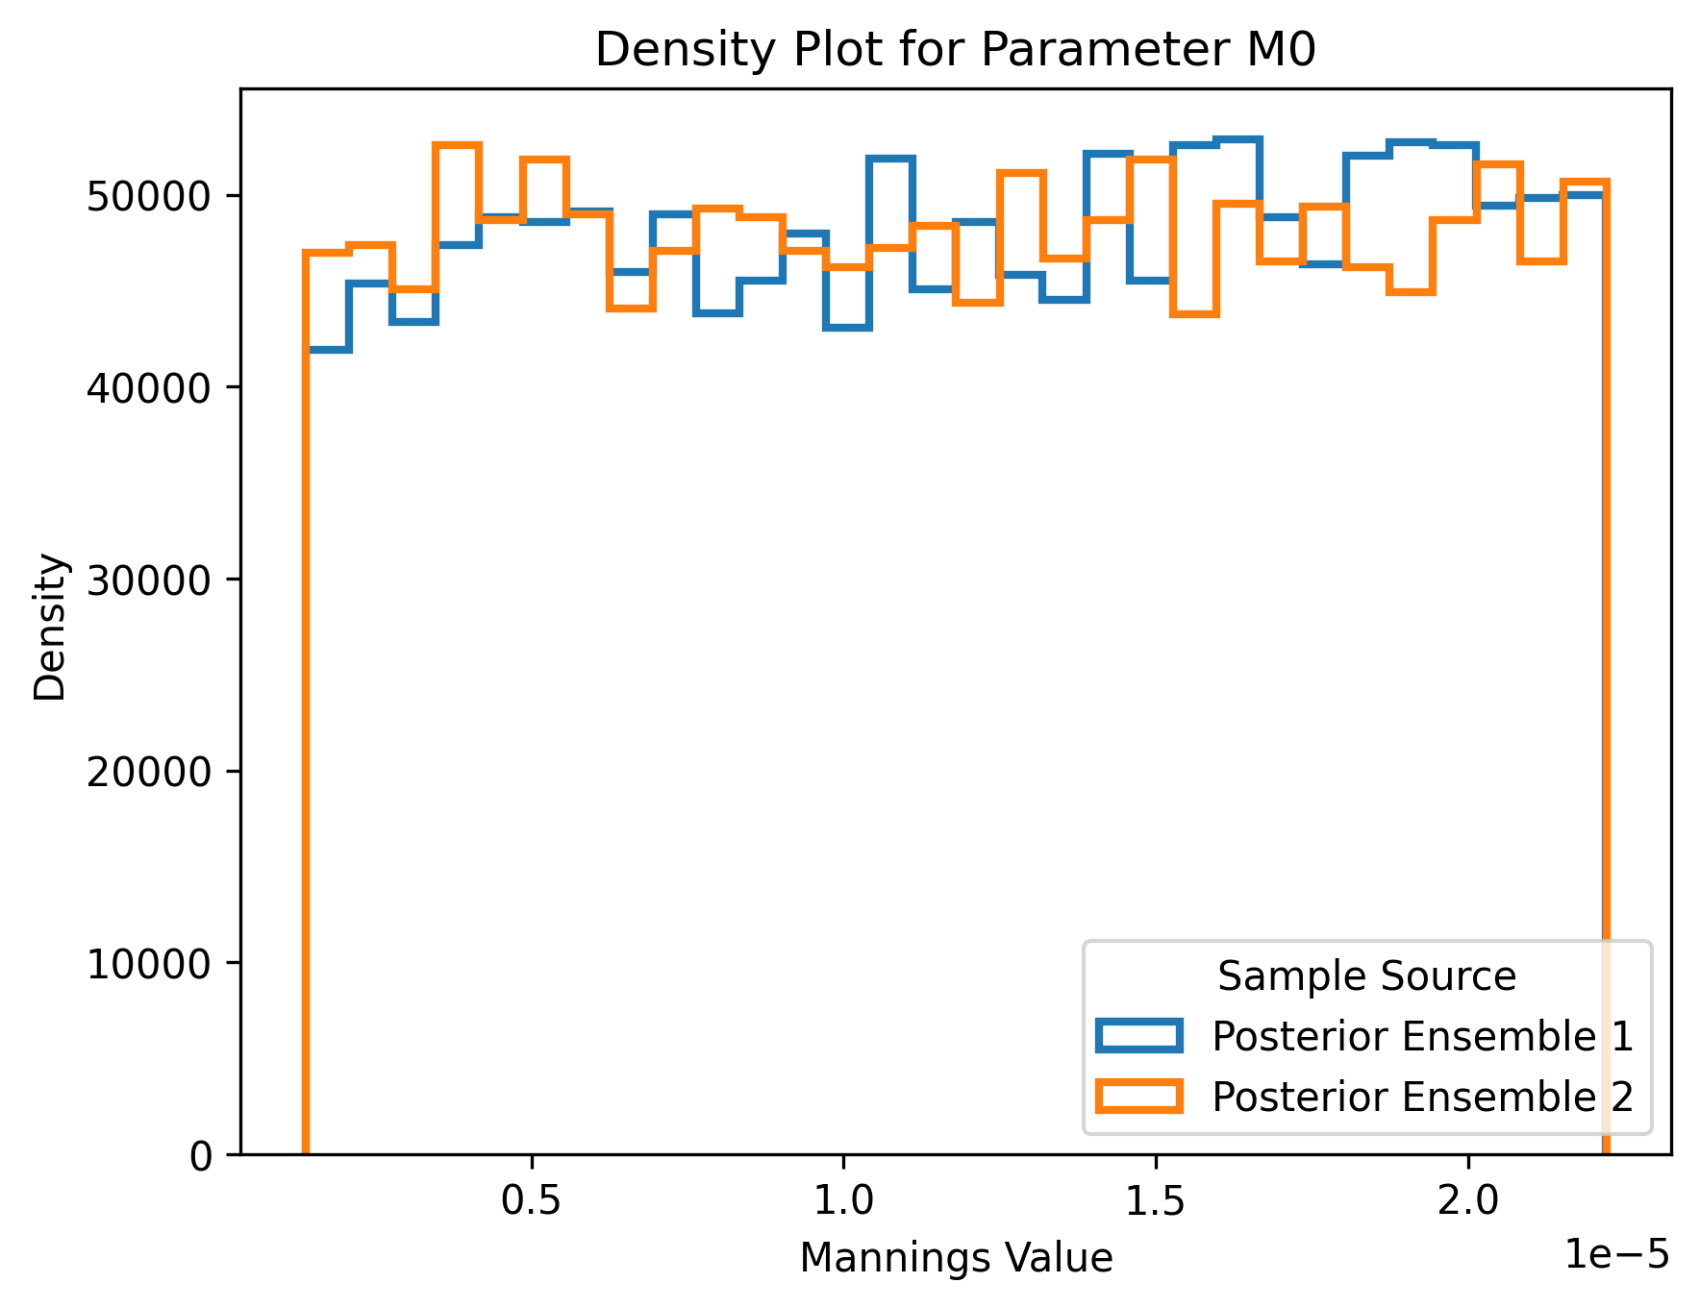
M0: Posterior Distribution
Notes:
Sampling 400 simulations
Posterior distribution that is presented is from the first iteration

Slide 110
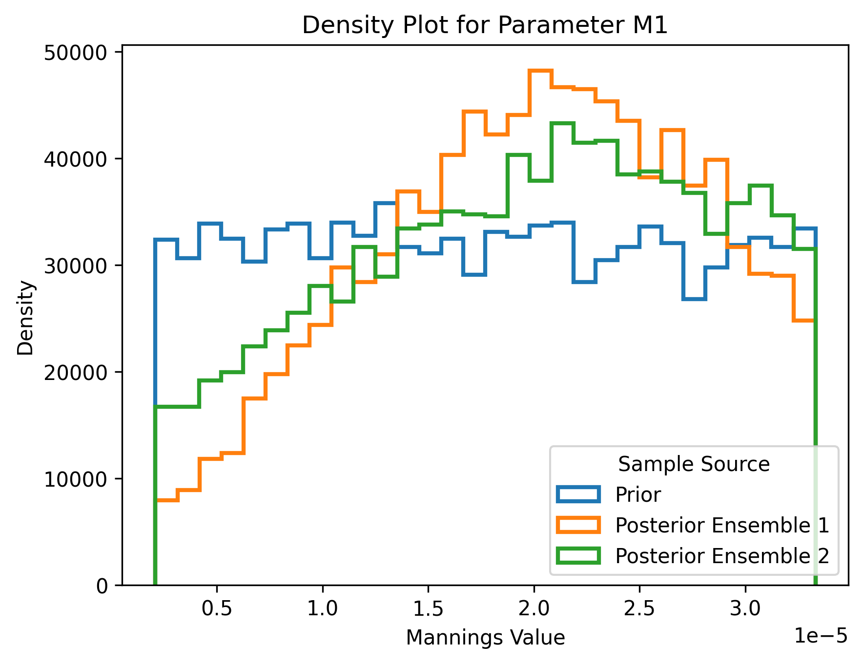
M1: Posterior Distribution
Notes:
Sampling 400 simulations
Posterior distribution that is presented is from the first iteration

Slide 111
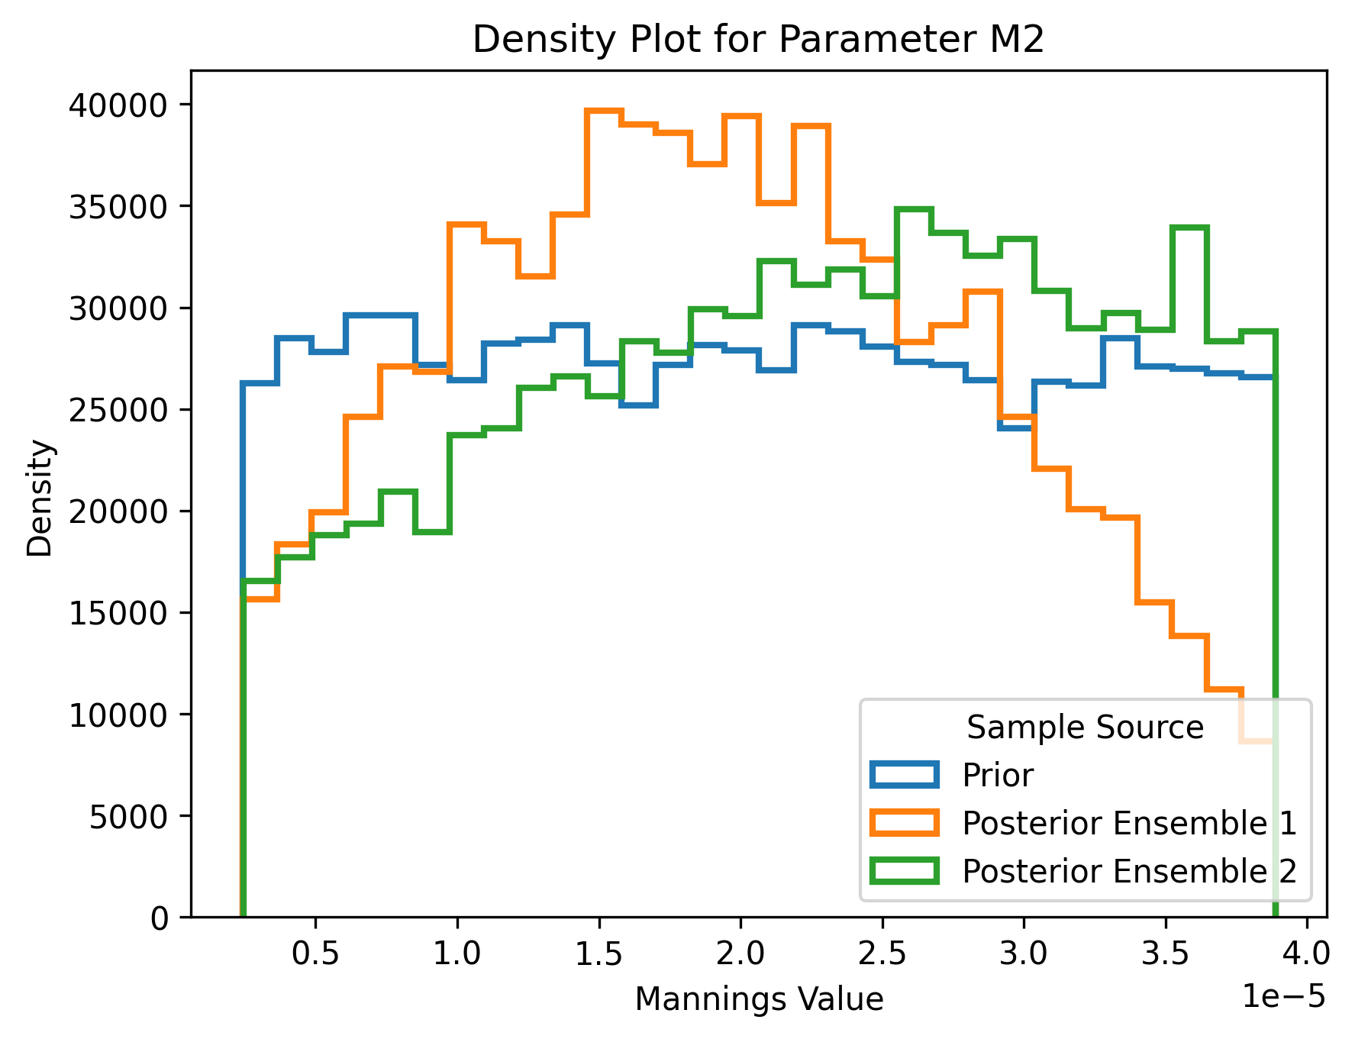
M2: Posterior Distribution
Notes:
Sampling 400 simulations
Posterior distribution that is presented is from the first iteration

Slide 112
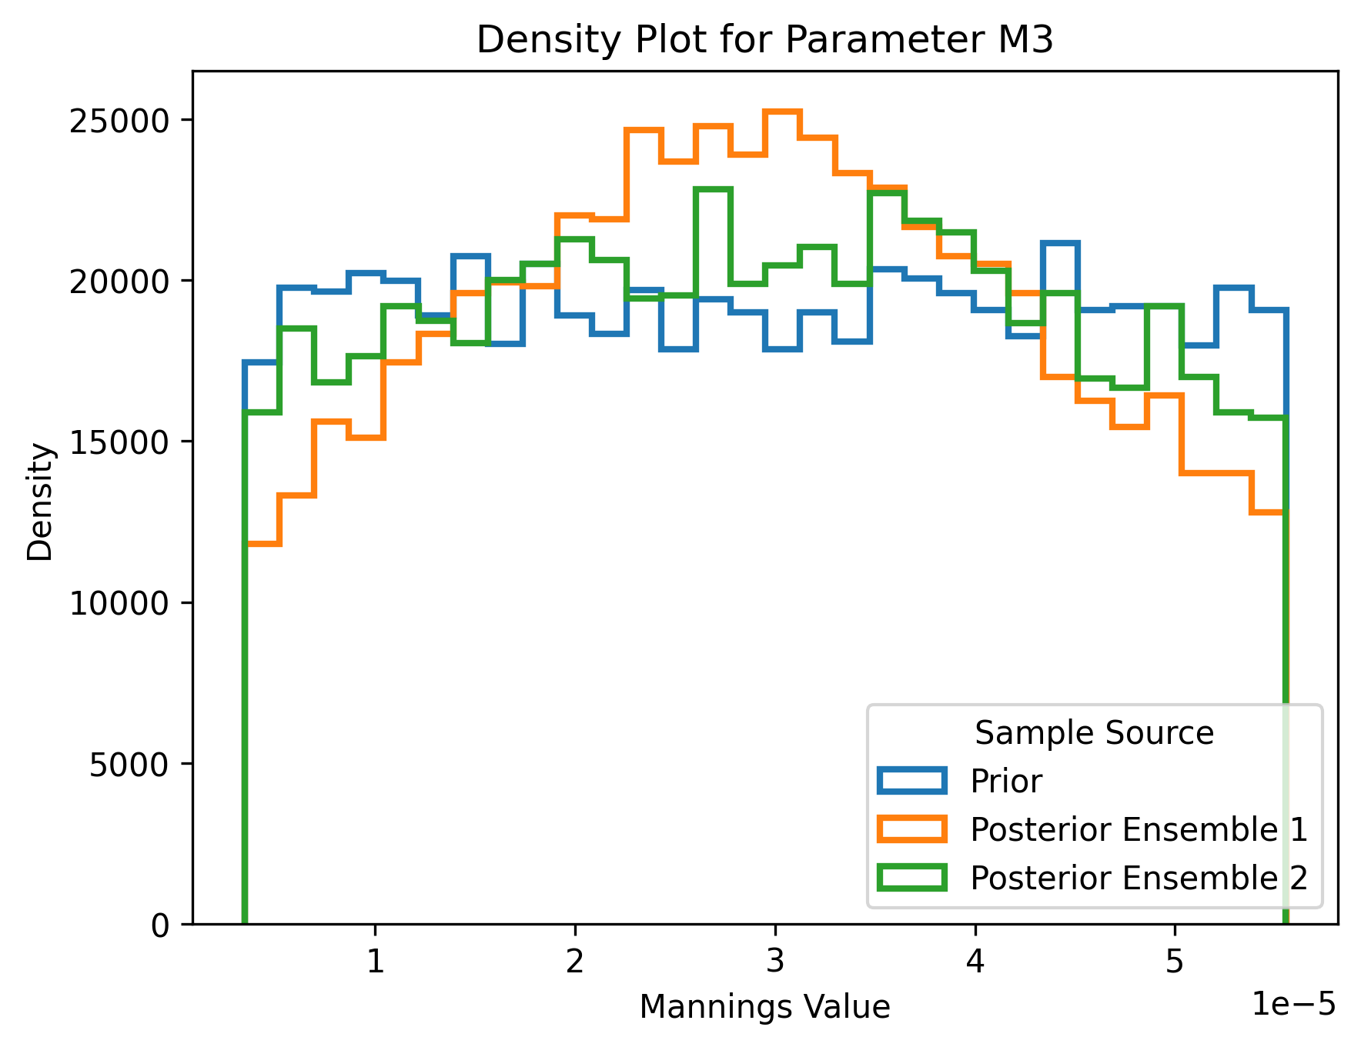
M3: Posterior Distribution
Notes:
Sampling 400 simulations
Posterior distribution that is presented is from the first iteration

Slide 113
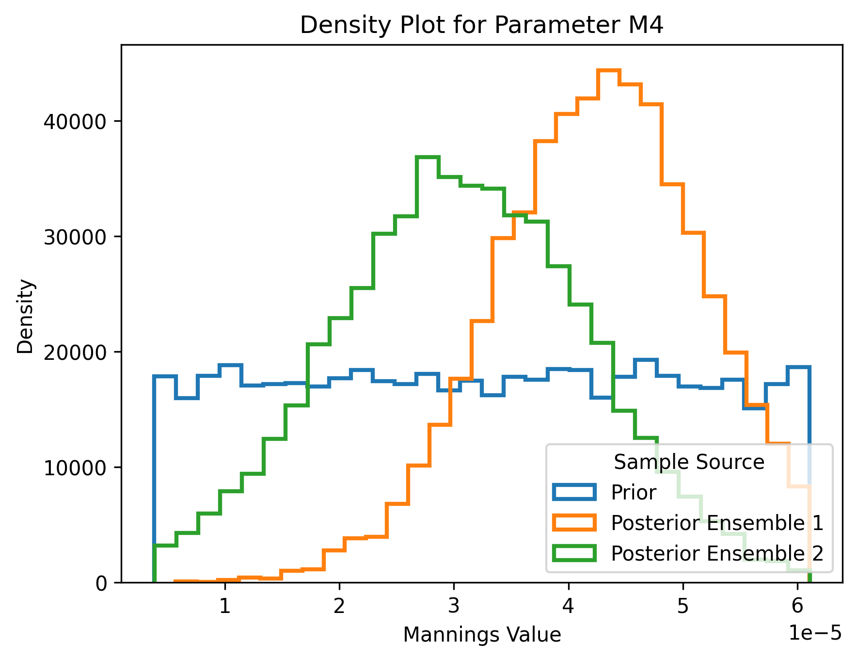
M4: Posterior Distribution
Notes:
Sampling 400 simulations
Posterior distribution that is presented is from the first iteration

Slide 114
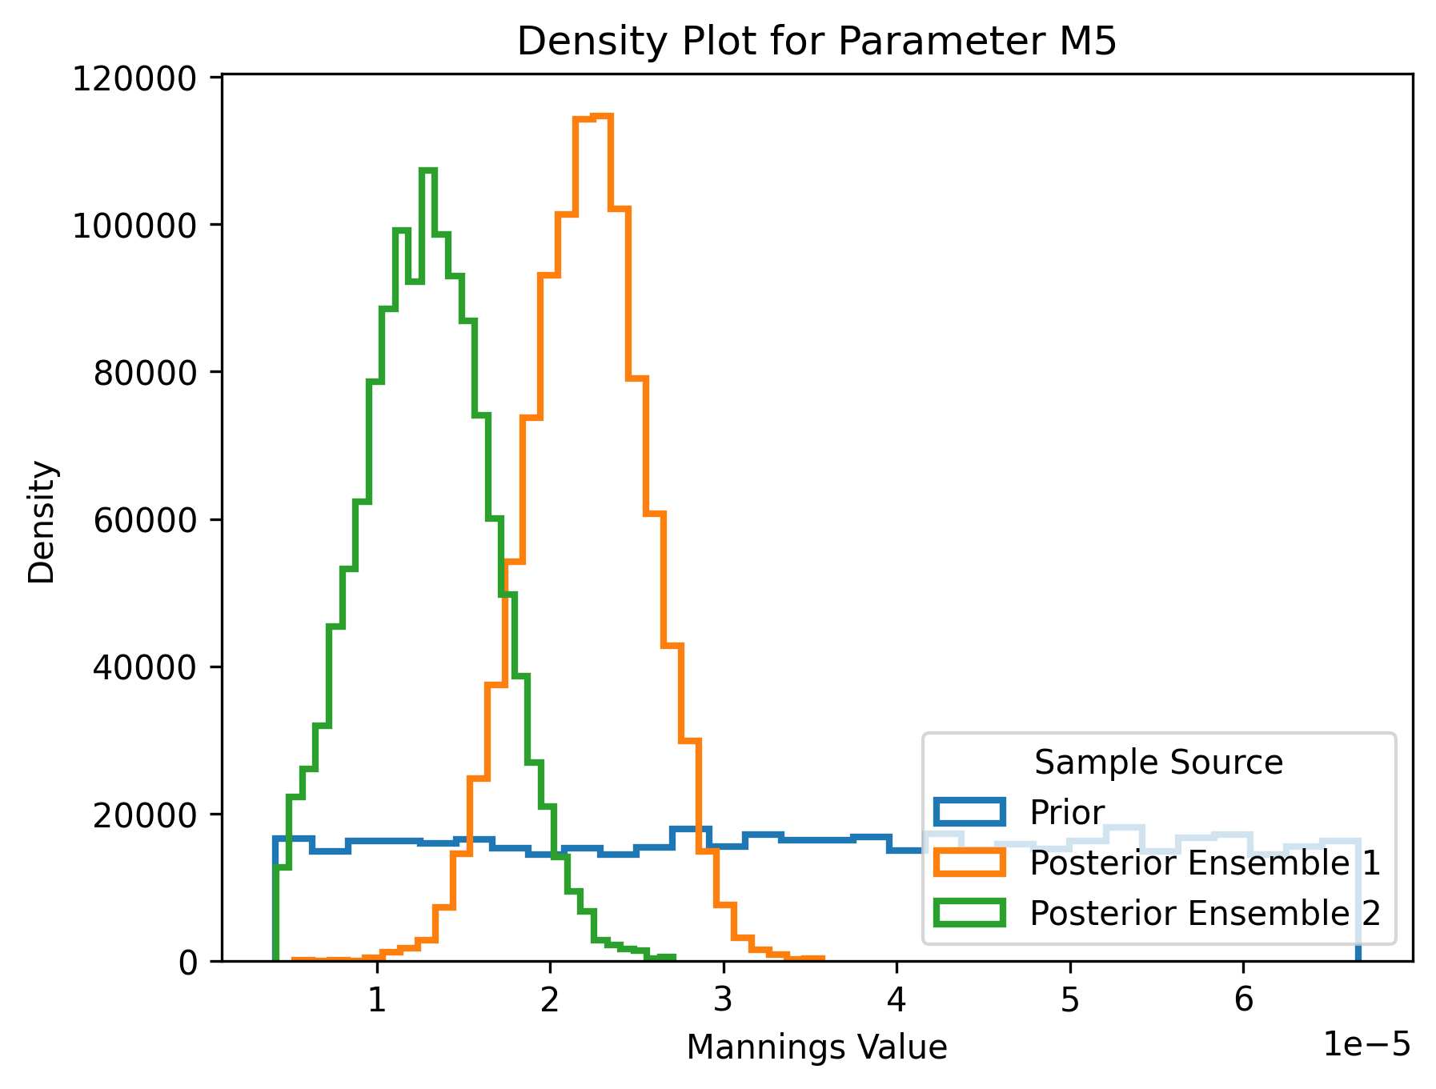
M5: Posterior Distribution
Notes:
Sampling 400 simulations
Posterior distribution that is presented is from the first iteration

Slide 115
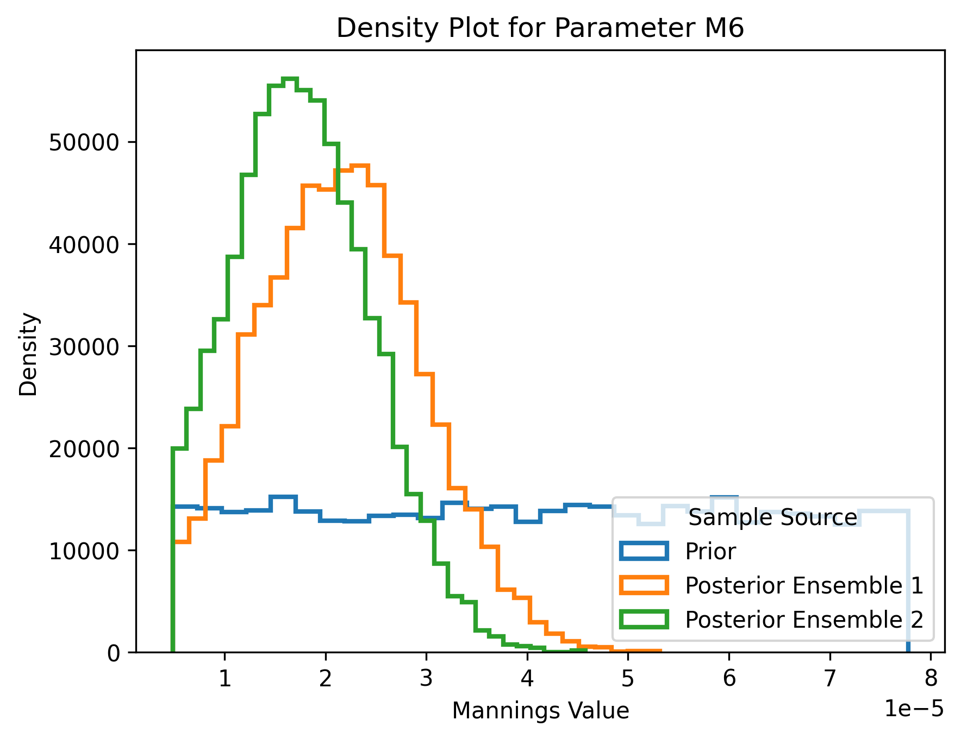
M6: Posterior Distribution
Notes:
Sampling 400 simulations
Posterior distribution that is presented is from the first iteration

Slide 116
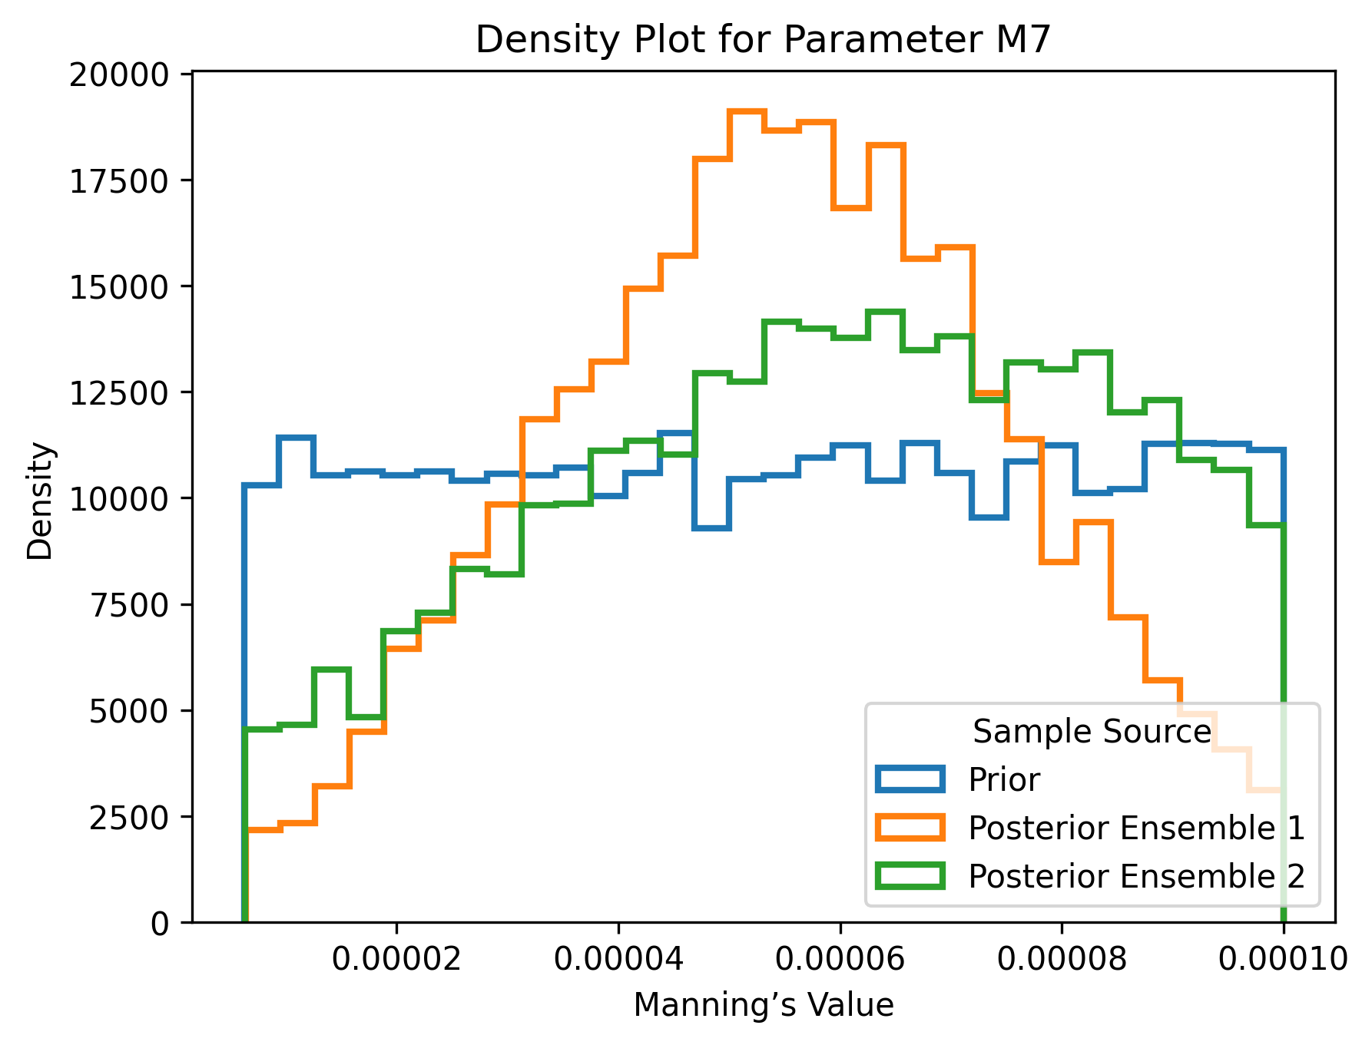
M7: Posterior Distribution
Notes:
Sampling 400 simulations
Posterior distribution that is presented is from the first iteration

Slide 117
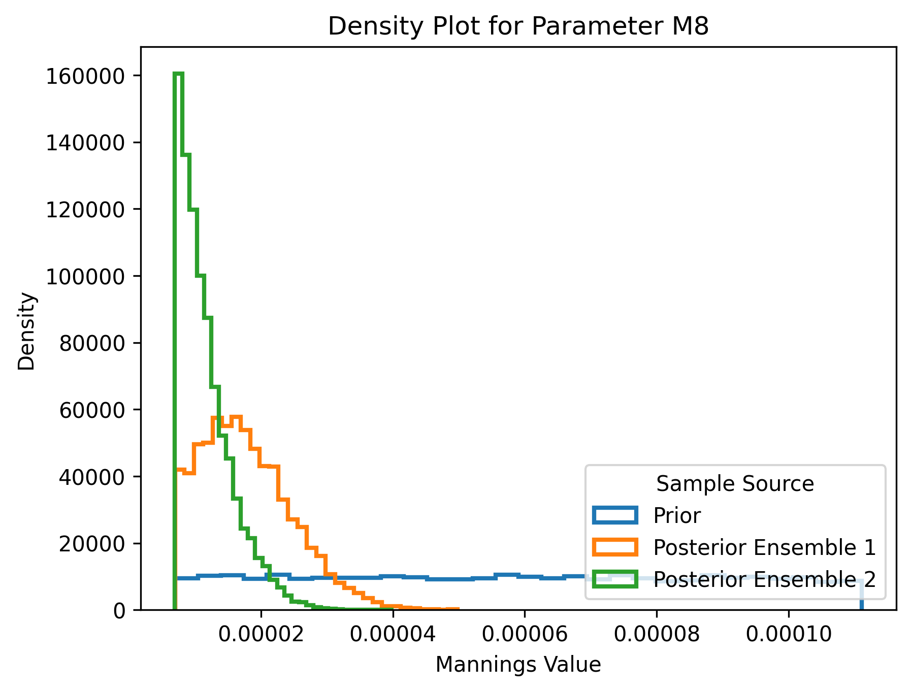
M8: Posterior Distribution
Notes:
Sampling 400 simulations
Posterior distribution that is presented is from the first iteration

Slide 118
Update Research 13 March 2025

Slide 119
Discussion Points
Analyzing the posterior density estimation after calibrating the prior distribution
Updating on my meeting with Dr. Peter Melchior and summarizing key discussion points

Slide 120
Spatial Manning’s Distribution

Slide 121

Manning’s Value and Land Cover

Slide 122
Discussion of Posterior Density Estimation after calibrating the prior distribution
The prior distribution appears appropriate for the following Manning’s values M0, M1, M2, M3,M5 and M6
The posterior densities for M4, M7, M8 indicate that the prior distribution may require adjustment
Notes:
The prior distribution appears appropriate for the following Manning’s values M0, M1, M2, M3,M5. and M6: The highest densities of the posterior distributions fall well within the prior range, suggesting adequate parameter coverage.
- M4: The highest posterior densities are concentrated near the left boundary of the prior range. This suggests that the prior range should be extended on the left side to better capture relevant parameter values.
- M7: The posterior distribution shows a clustering of highest density estimates on the right side. This suggests that the right boundary should be extended to ensure sufficient parameter coverage.
- M8: The posterior distribution is poorly aligned with the prior, as the highest density is concentrated on the left side, while the middle-to-right range has nearly zero density. This misalignment suggests that the prior should be adjusted by expanding the parameter range on the left side.

Slide 123
Meeting Summary with Dr. Peter Melchior
Discussion of Prior and Posterior Distributions
Calibration of Prior Distribution
Selecting Minimum and Maximum Noise
Calibration of Hyperparameters
SNPE and NLE

Slide 124
Meeting Summary with Dr. Peter Melchior
Optimization
Joint and Marginal Probability
Sampling with MCMC
Equifinality Problem

Slide 125
Update Research 20 March 2025

Slide 126


Spatial Manning’s Distribution

Slide 127

Elevation Mapping

Slide 128

Ensemble 1: Manning’s values with the highest density estimation

Slide 129


Hydrograph Ensemble 1

Slide 130


Hydrograph Ensemble 1

Slide 131


Hydrograph Ensemble 1

Slide 132

Ensemble 2: Manning’s values with the highest density estimation

Slide 133


Hydrograph Ensemble 2

Slide 134


Hydrograph Ensemble 2

Slide 135


Hydrograph Ensemble 2

Slide 136

Noise Distribution

Slide 137
Update Research 27 March 2025

Slide 138
Discussion Points
Resolution of CONUS 2 Domain
Spatial Mapping of USGS Gage Stations to the Model Grid
Effect of Grid Resolution on Manning’s Roughness
Additional Sources of Uncertainty and Discrepancy between Streamflow Generated from ParFlow and the Observed data from USGS

Slide 139
Discussion Points
Resolution of CONUS 2 Domain
Spatial Mapping of USGS Gage Stations to the Model Grid
Effect of Grid Resolution on Manning’s Roughness
Additional Sources of Uncertainty and Discrepancy between Streamflow Generated from ParFlow and the Observed data from USGS

Slide 140
Discussion Points
Explanation in details how these factors affect the training of SBI to capture the true manning's value of the observed data from USGS
Approach to address misalignment between ParFlow and observed data
Quantifying the difference resulting from the Parflow data as well as from the observed data

Slide 141
Discussion Points
Dr. Peter Melchior’s discussion
Manage a slot for Louisa to present her poster for EGU
Title for my poster : Last Slide in the presentation
Preparation for my CEE 509 poster

Slide 142
Discussion Points
Certificate for APC 523/524

Slide 143
CEE 509: Poster
Simulation-Based Inference for Estimating Manning’s Roughness Parameters in the ParFlow Hydrologic Model
Estimating Manning’s Parameters in ParFlow Model using Simulation Based Inference (SBI)
Using Simulation-Based Inference to Estimate Manning’s Parameters in the ParFlow Model
Estimate Manning’s Parameters in the ParFlow Model with Simulation-Based Inference (SBI)

Slide 144
Update Research April 3, 2025

